Slide 1
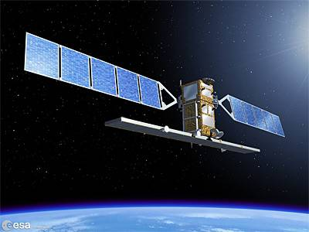
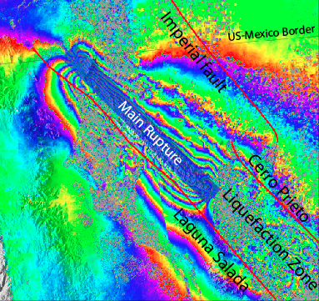
GMTSAR Short Course
UNAVCO, July 2014
David Sandwell, Rob Mellors,
Xiaopeng Tong, Scott Baker
Objectives:
  run GMT and GMTSAR on your own computer
  perform 2-pass InSAR processing on your own computer
  data (ERS, Envisat, ALOS-1) from UNAVCO and ASF
  prepare large stacks of interferograms
  time series (see next UNAVCO InSAR short course August 4 - 6)
Notes:
1

Slide 2
GMTSAR Short Course
OUTLINE
setup UNIX, GMT, and GMTSAR – test cases
overview of SAR and InSAR – Burgmann et al., 2002
learn to select SAR scenes at UNAVCO and ASF
SAR and InSAR theory
GMTSAR overview, modules, standard InSAR processing
2-D phase unwrapping
batch processing
imaging earthquakes
student presentations
Notes:
2

Slide 3
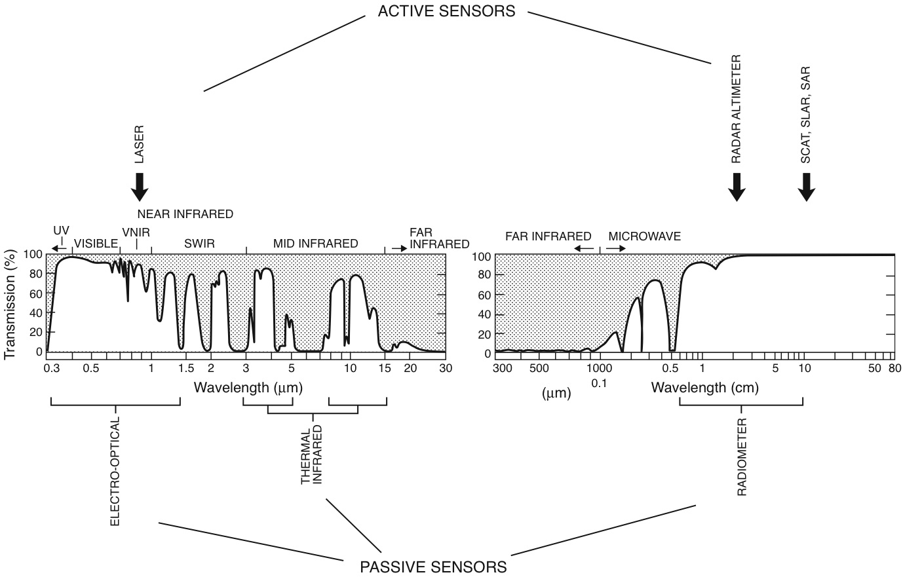
passive and active remote sensing – optical and microwave

Slide 4
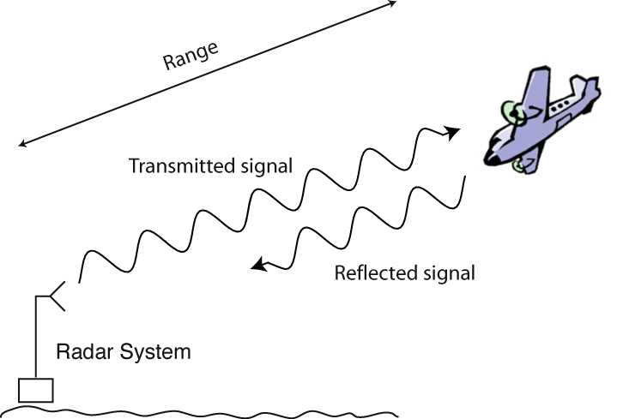
Radar
RADAR: “Radio Detection and Ranging”
EM waves - Active System (own illumination)
Principle (like any EM ranging method):
  Create a pulse of oscillating EM energy
  frequency f, and duration τ
  scatter
  return of some energy to radar
  λ = c/f
  R = ct/2, Measures time of flight of EM pulses
[Burgmann et al., 2000]

Slide 5
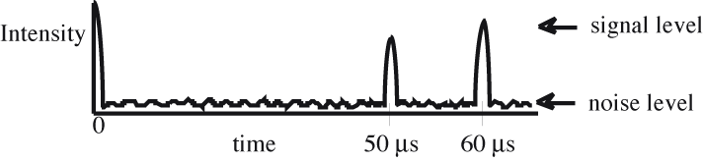
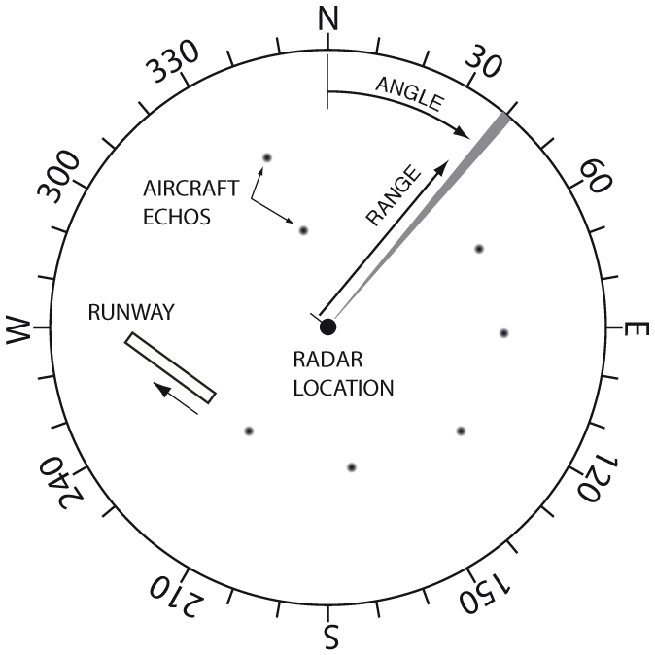
Radar Location
RADAR: “Radio Detection and Ranging”
[Burgmann et al., 2000]
H. Zebker

Slide 6
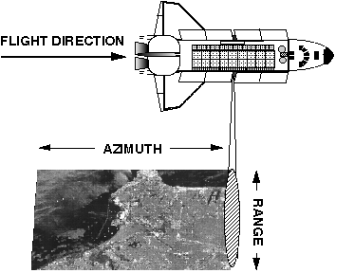
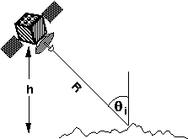
Radar Geometry
Range
Directions
Track
from http://southport.jpl.nasa.gov/desc/imagingradarv3.html
[Burgmann et al., 2000]
Notes:
The length of the radar antenna determines the resolution in the azimuth (along-track) direction of the image: the longer the antenna, the finer the resolution in this dimension. Synthetic Aperture Radar (SAR) refers to a technique used to synthesize a very long antenna by combining signals (echoes) received by the radar as it moves along its flight track. Aperture means the opening used to collect the reflected energy that is used to form an image. In the case of a camera, this would be the shutter opening; for radar it is the antenna. A synthetic aperture is constructed by moving a real aperture or antenna through a series of positions along the flight track.
As the radar moves, a pulse is transmitted at each position; the return echoes pass through the receiver and are recorded in an 'echo store.' Because the radar is moving relative to the ground, the returned echoes are Doppler-shifted (negatively as the radar approaches a target; positively as it moves away). Comparing the Doppler-shifted frequencies to a reference frequency allows many returned signals to be "focused" on a single point, effectively increasing the length of the antenna that is imaging that particular point. This focusing operation, commonly known as SAR processing, is now done digitally on fast computer systems. The trick in SAR processing is to correctly match the variation in Doppler frequency for each point in the image: this requires very precise knowledge of the relative motion between the platform and the imaged objects (which is the cause of the Doppler variation in the first place).
Synthetic aperture radar is now a mature technique used to generate radar images in which fine detail can be resolved. SARs provide unique capabilities as an imaging tool. Because they provide their own illumination (the radar pulses), they can image at any time of day or night, regardless of sun illumination. And because the radar wavelengths are much longer than those of visible or infrared light, SARs can also "see" through cloudy and dusty conditions that visible and infrared instruments cannot.
from http://southport.jpl.nasa.gov/desc/imagingradarv3.html

Slide 7
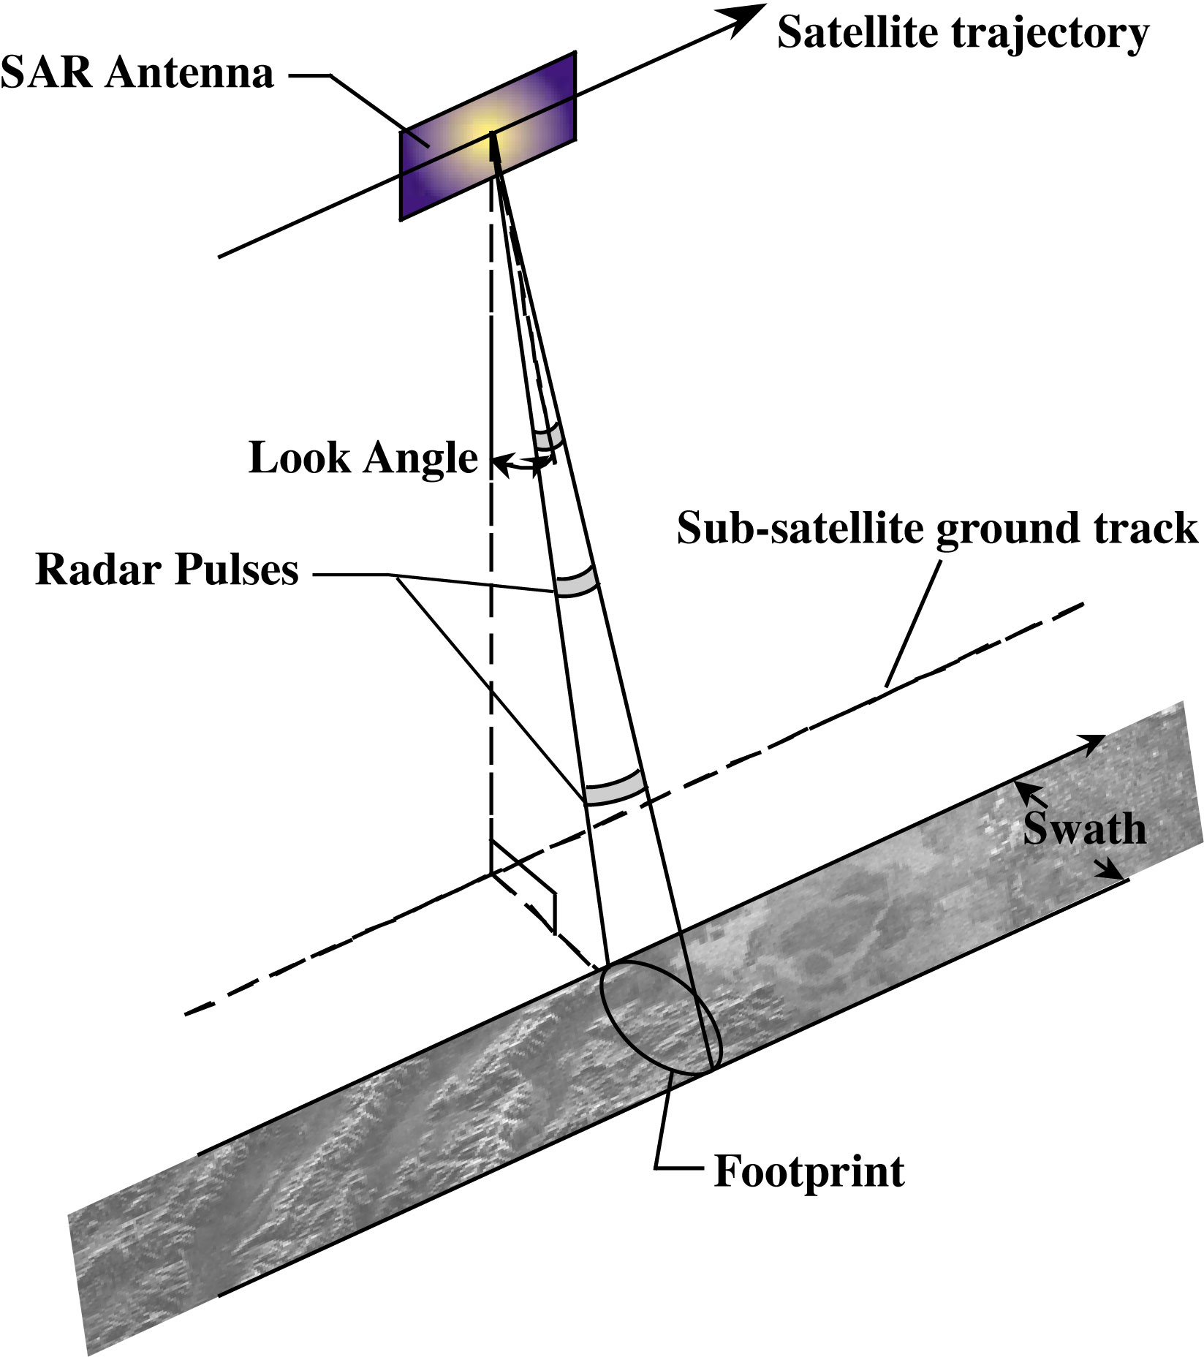

Slide 8
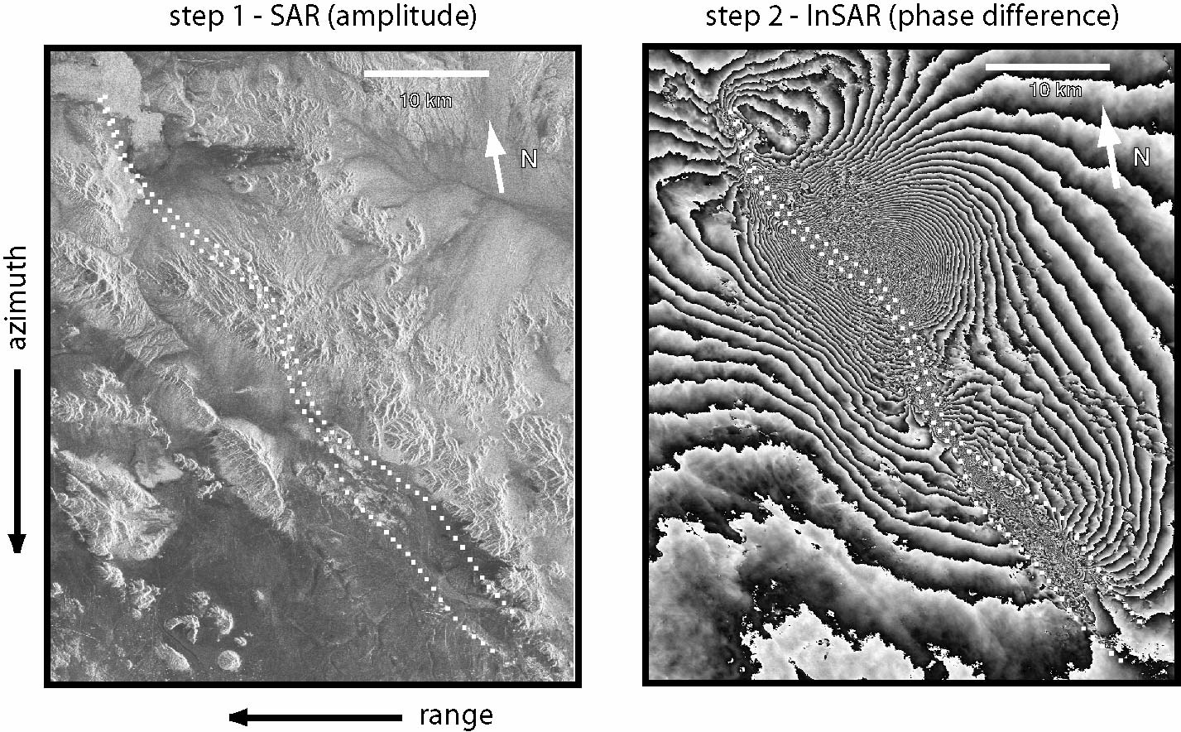
amplitude and phase

Slide 9
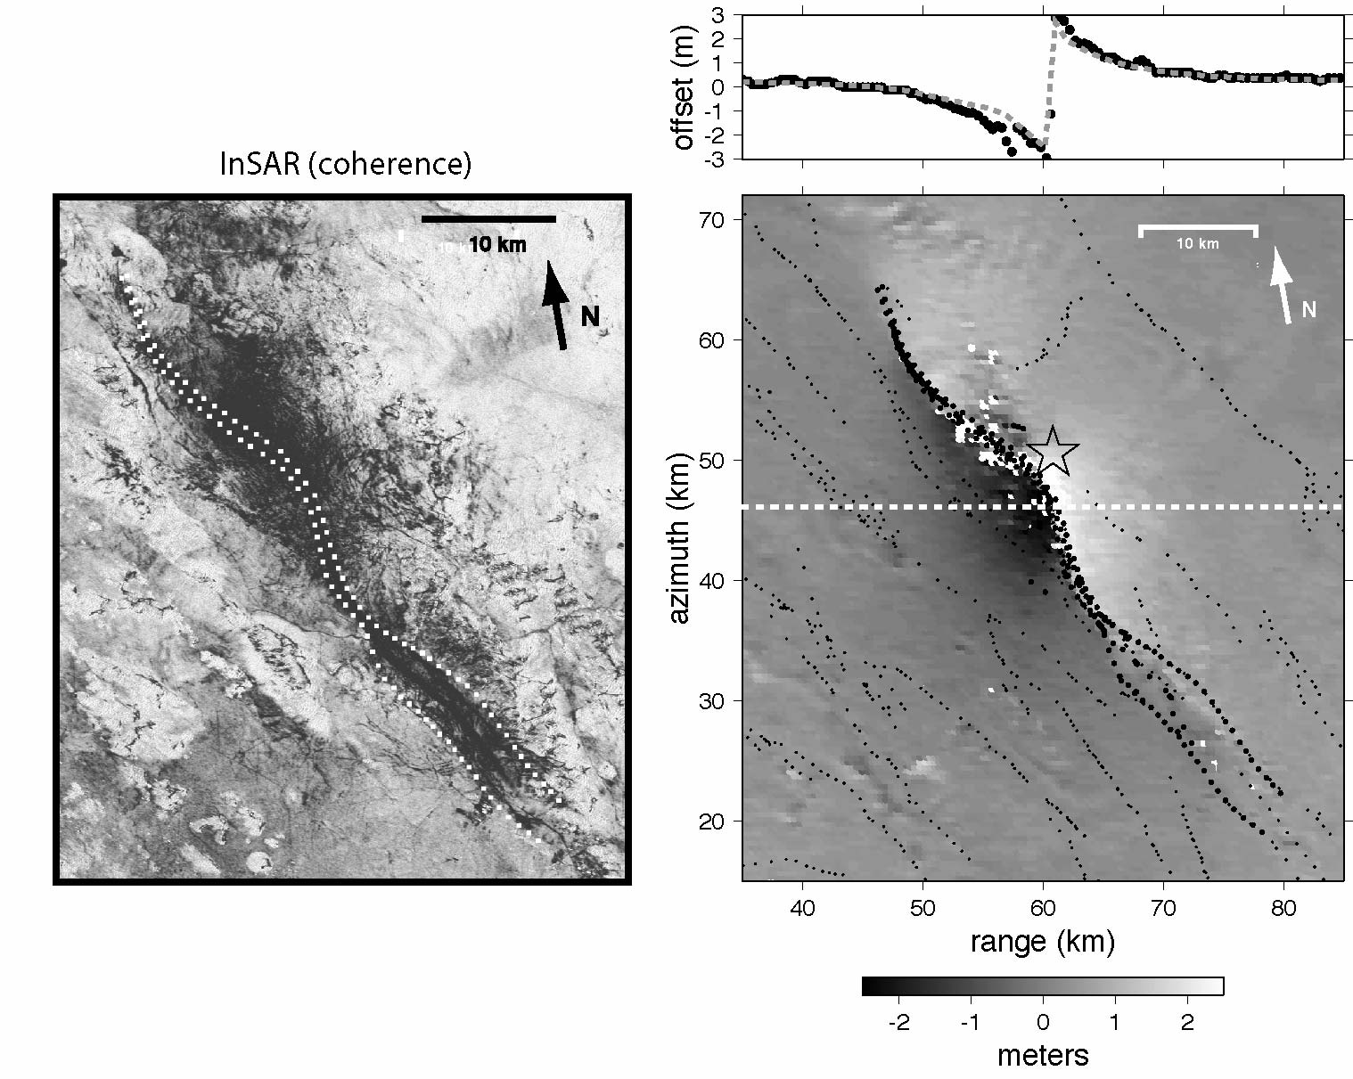
coherence and pixel matching

Slide 10
Pinon Flat

Slide 11
ERS
Tracks (501 orbits per repeat cycle)
Frames (6041 seconds per orbit)
T356
F2925

Slide 12
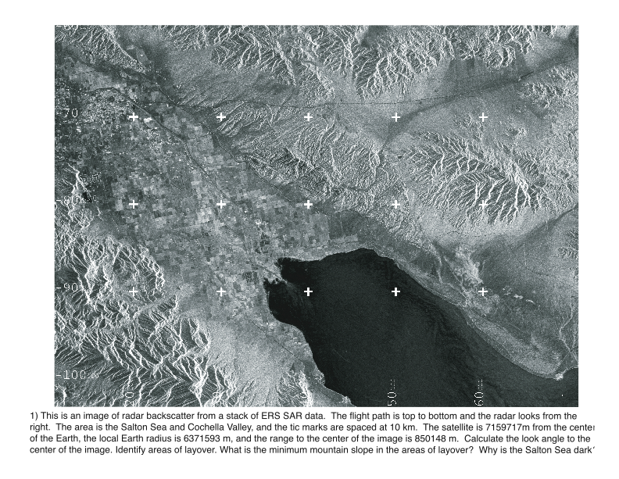
ERS amplitude image

Slide 13
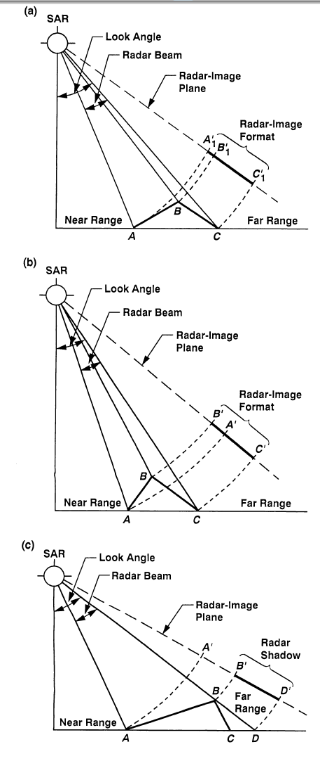
geometry
foreshortening
layover
shadowing

Slide 14
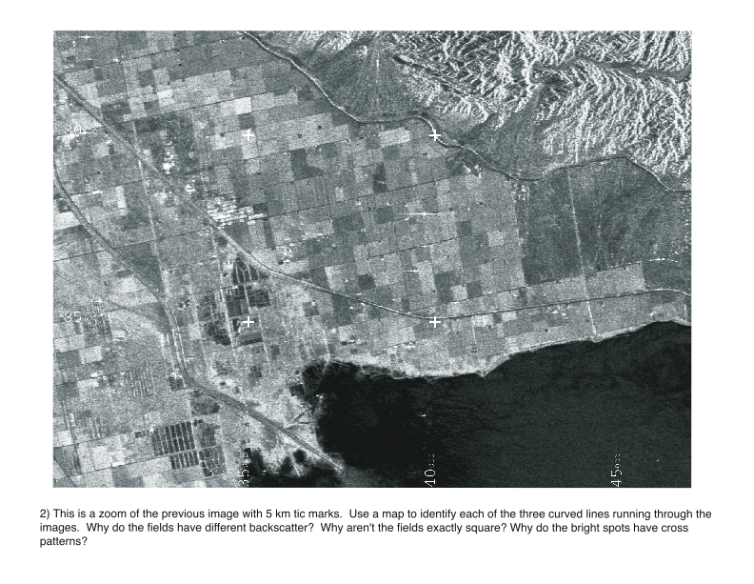
zoom of amplitude image

Slide 15
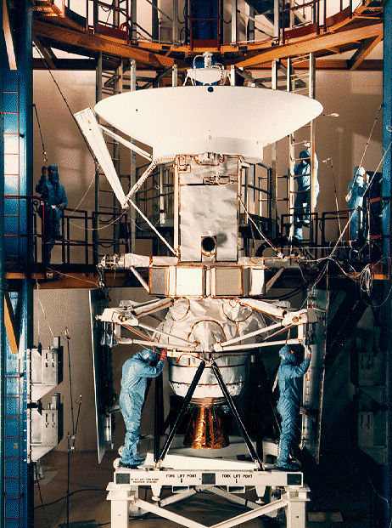
Magellen SAR
1990-1994

Slide 16
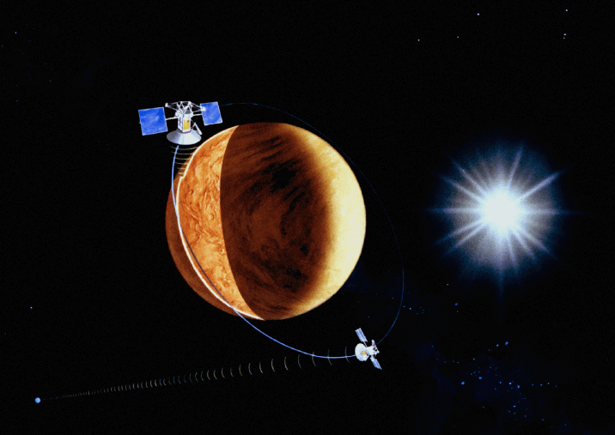
Magellen SAR 1990-1994 at Venus

Slide 17
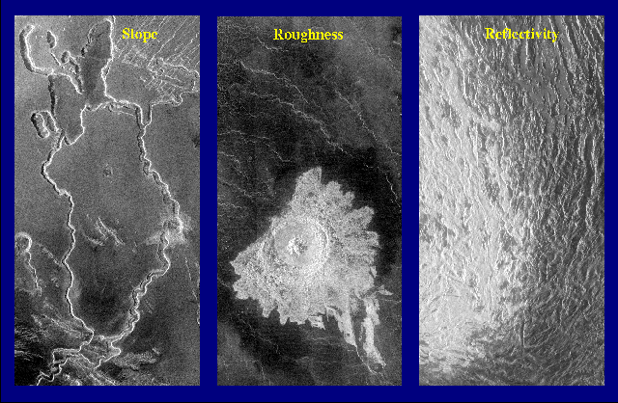
Radar Image Properties
SLOPE
ROUGHNESS
REFLECTIVITY
Surface
Notes:
17
•Left-looking. Left panel, lava channels on the southern slopes of Ovda Regio show the effects of topographic slope. Slopes facing away from the spacecraft (to the east) are elongated and appear to be in shadow, while west-facing slopes are foreshortened and radar-bright.
• The center panel shows Aurelia Crater. The brightness of the crater's ejecta and floor deposits indicates a surface that is very rough at the centimeter-scale-operating wavelengths of the SAR.
• In the right panel, notice that while the landforms do not appear to change much across the image, the western half of the image appears brighter. The western portion of the image is the southeastern portion of Maxwell Montes: At elevations greater than about 4 kilometers above mean planetary radius, the mountains are inherently more reflective, much like aluminum foil is more reflective than paper. High reflectivity at high elevations is nearly universal on Venus and is thought to represent differences in chemical weathering of rocks at high and low elevations. Reflective stuff found at Atla, Ishtar, Beta. (iron pyrite -- fools good)
The left and center images are 90 x 180 kilometers, and the right image is 240 x 480 kilometers.
Reminder: Moon dark/light were visible images - indicate composition: dark (mare), light (cratered highlands)

Slide 18
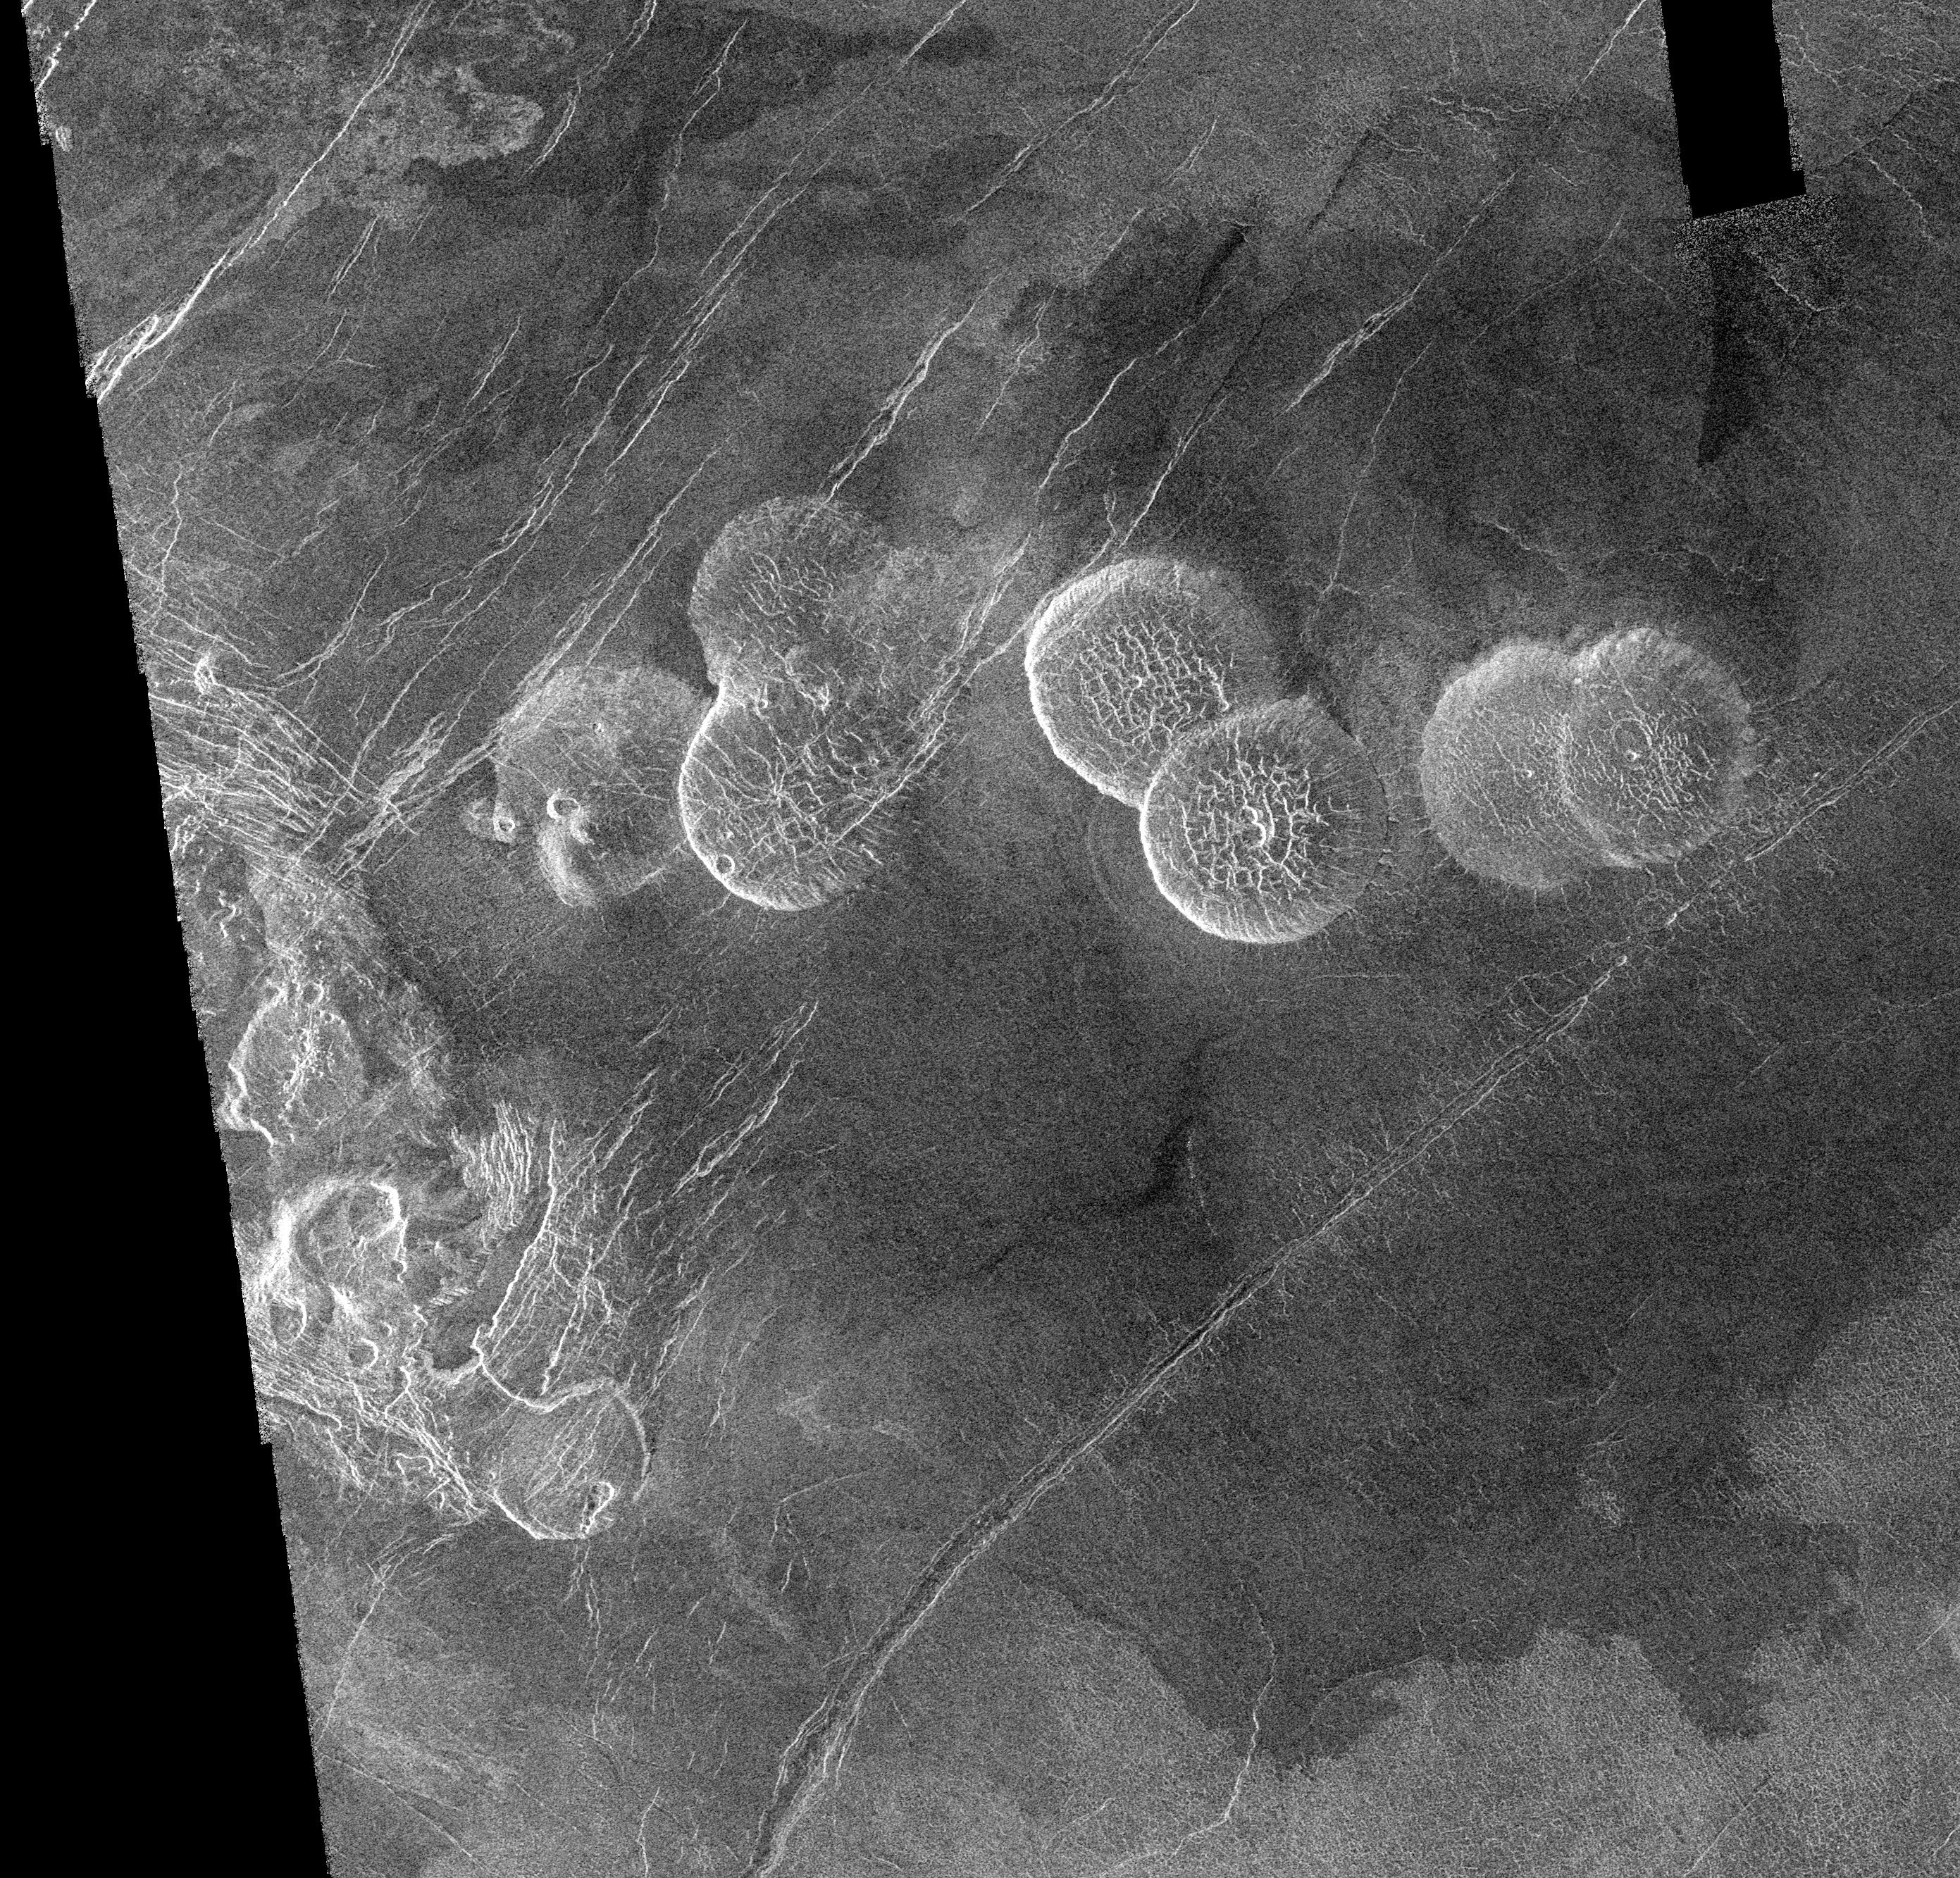
slope
pancake
domes
Venus

Slide 19
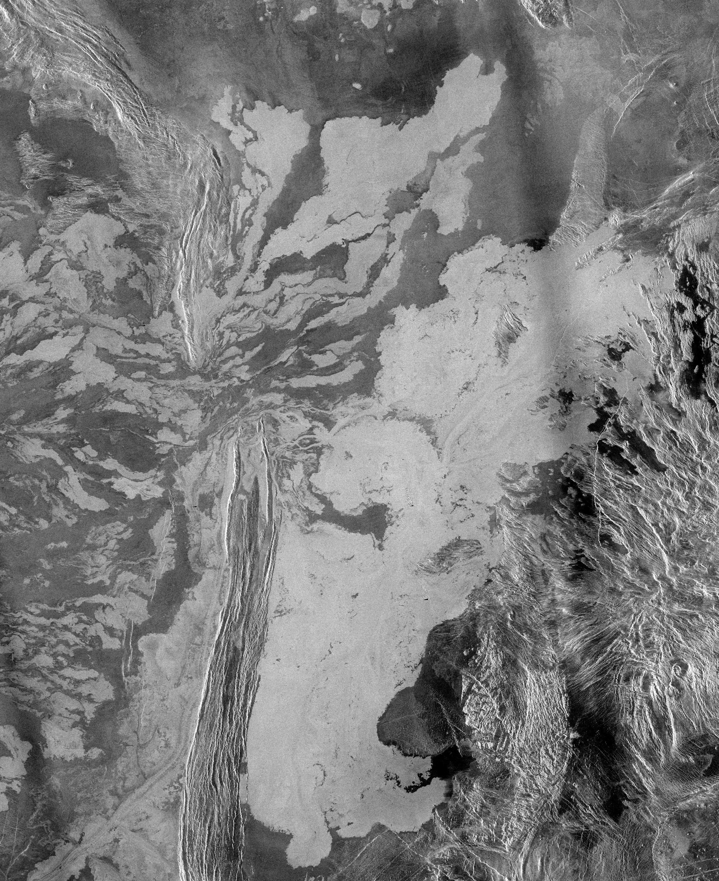
roughness
lava flows
Venus

Slide 20
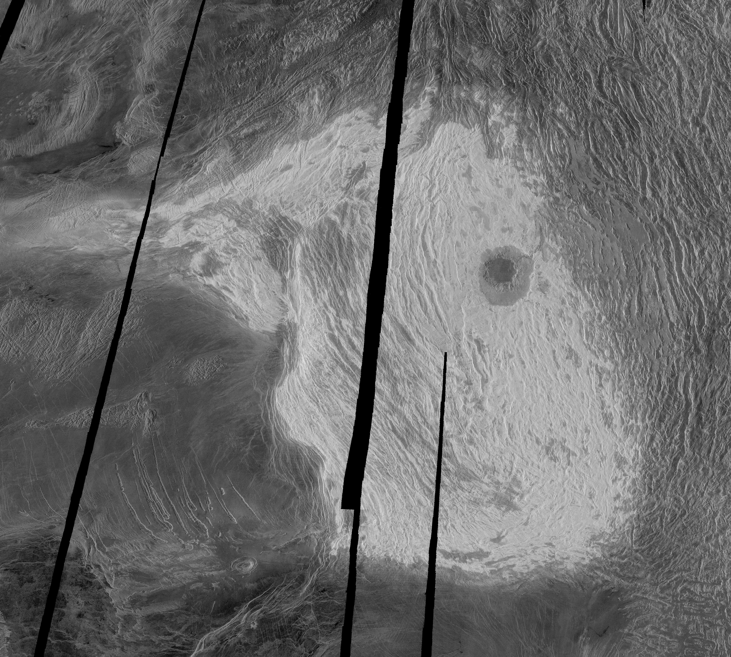
reflectivity
Maxwell Montes
Venus

Slide 21
InSAR uses phase

Slide 22
Research with ALOS PALSAR data
within the WinSAR consortium
Matt Pritchard, Cornell (Chair)
and the WinSAR Executive Committee
Roland Burgmann, Yuri Fialko, Eric Fielding and David Schmidt
Outline of talk:
What is WinSAR ?
Research examples:
Earthquakes
Inter-seismic
Volcanoes
Subsidence
Others
Recommendations

Slide 23
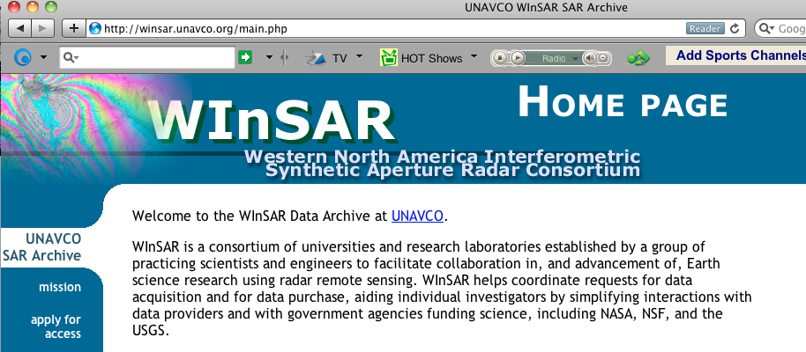

What is WinSAR ?
Consortium of 83 Universities/ Research Institutions (~20 non U.S.)
- Executive Committee (elected, 2-year terms)
- ALOS-PALSAR access through L1 data pool at ASF (U.S. Government Research Consortium, USGRC)
Funding:

Slide 24
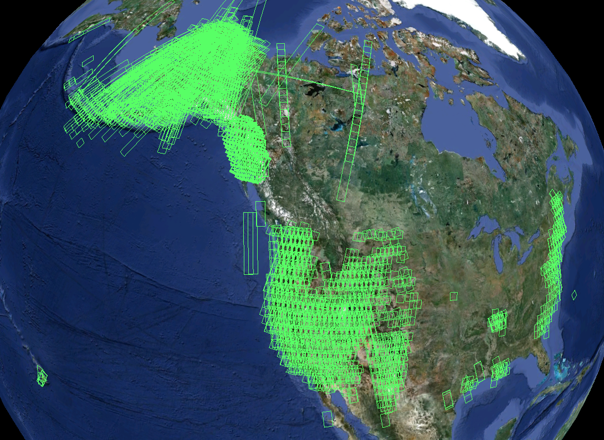
WinSAR objectives
• Promote the use and development of InSAR technology for scientific investigations.
• Promote free and open access to SAR data as allowed by data providers.
Acquire, archive and catalog SAR data of the U.S. active areas
Complete ERS,Envisat
data sets for core area!
# of scenes
ERS 22826 8.9 Tb
Envisat 7185 1.7 Tb
Nearly complete
ALOS-1 data set for North and South
America available at
ASF L1 Data Pool.

Slide 25
Volcanic Hazards

Slide 26
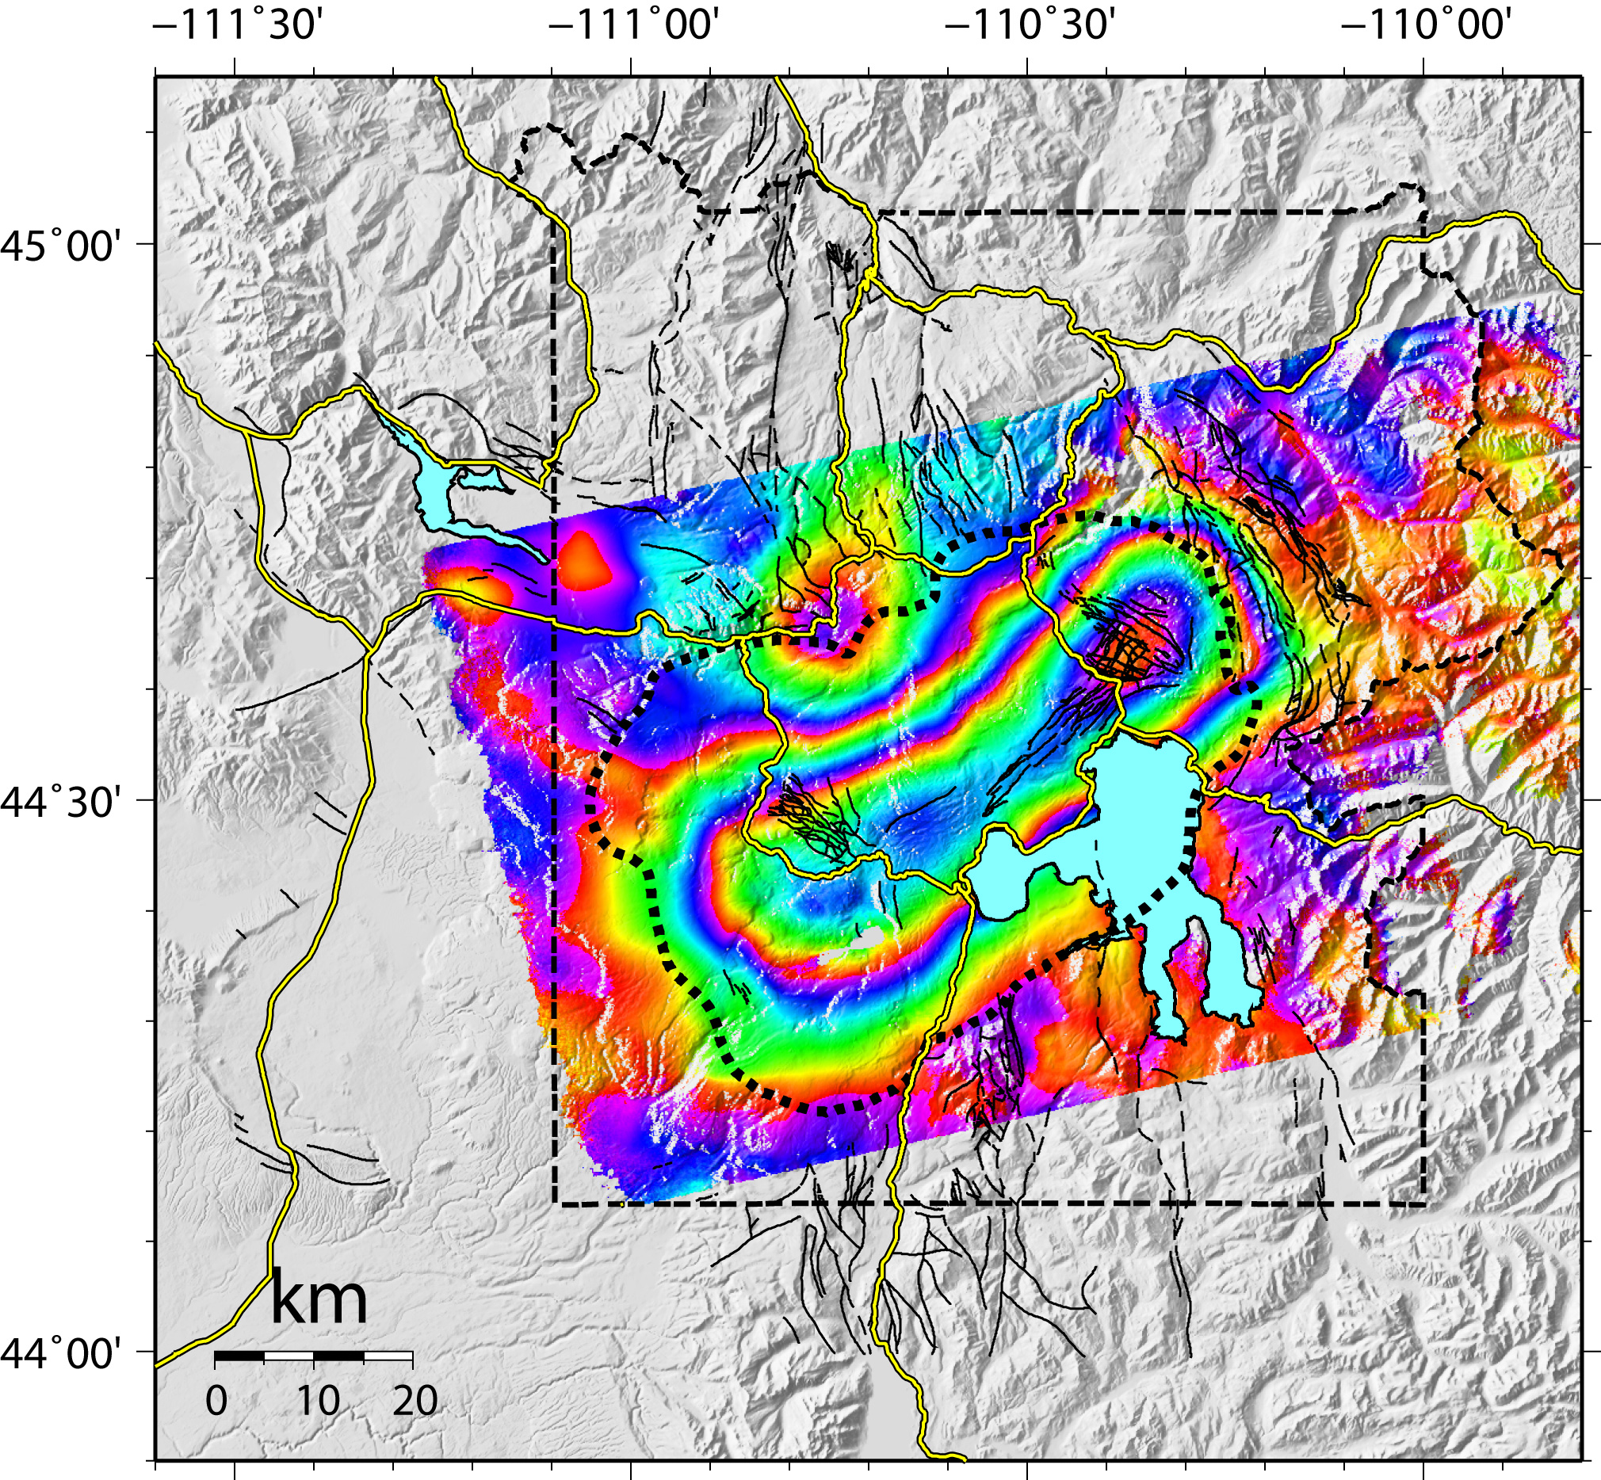
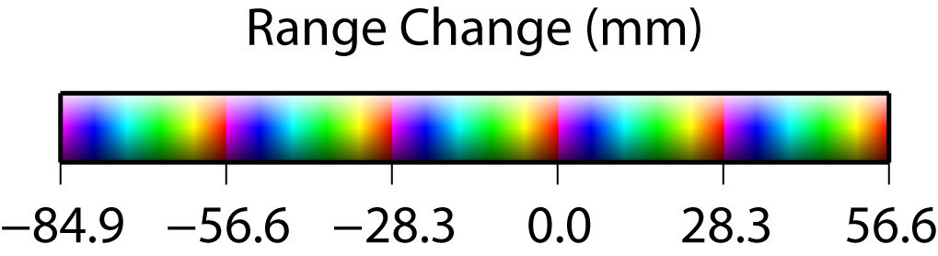

Yellowstone Caldera
ENVISAT IS1
Record one-year uplift using Space Based Geodesy
B⊥ = 231 m
2004/10/08 to 2005/09/23
C. Wicks, USGS
Notes:
ENVISAT IS1 Track 048 (ascending). Orbits 13629 and 18639. NOAA’s NOHRSC website shows the ground bare of snow during each acquisition date.

Slide 27
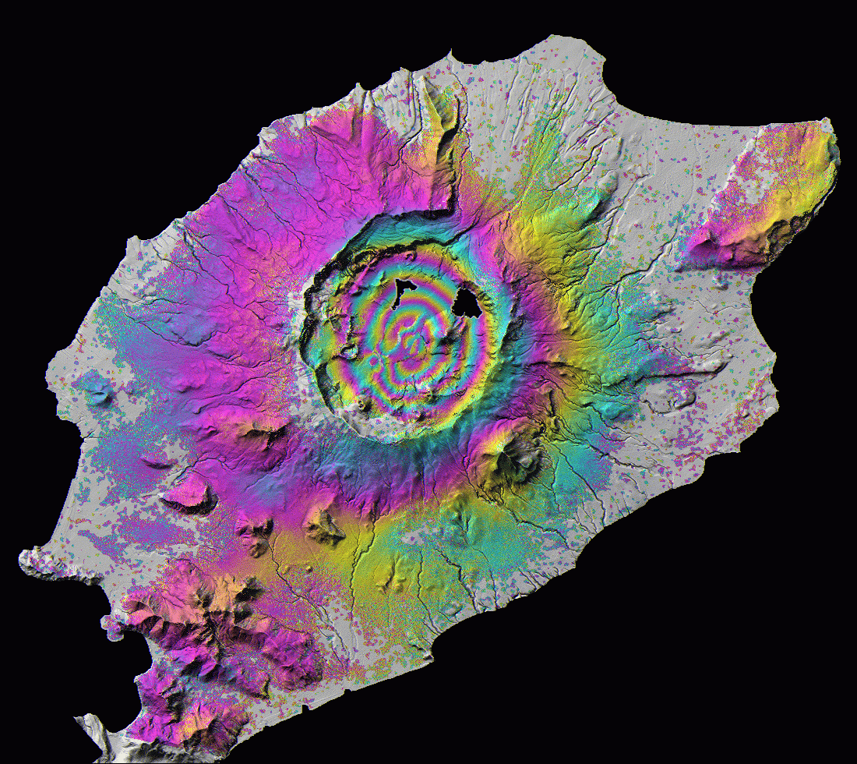
ENVISAT interferogram of Okmok volcano, Alaska, spanning 2003-2004. Located in the central Aleutian arc, Alaska, Okmok is a dominantly basaltic complex topped with a 10-km-wide caldera that formed circa 2.05 ka. Okmok erupted several times during the 20th century, most recently in 1997; eruptions in 1945, 1958, and 1997 produced lava flows within the caldera. Previous studies utilizing InSAR images from ERS-1, ERS-2, and Radarsat-1 sensors have shown that the inflation rate after the 1997 eruption generally decreased with time during 1997-2001, but increased significantly during 2001-2003. This recent interferogram shows continued inflation during 2003-2004 at a rate of about 60% that during 2002-2003. The InSAR image also shows post-emplacement deformation of the 1997 lava flow, most likely due to thermal contraction.
N
5 km
unpublished data from Zhong Lu
0
28 mm

Slide 28
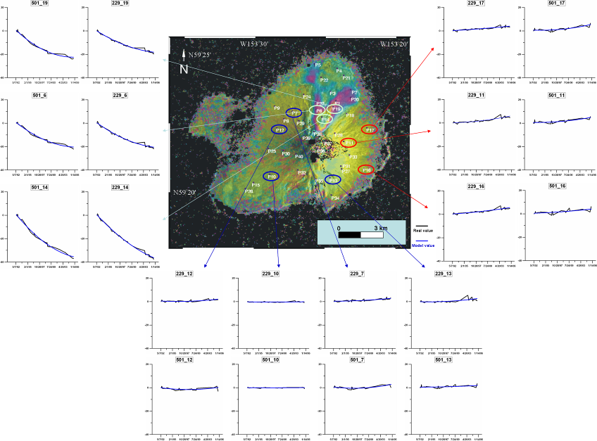
Averaged InSAR image from track 229 created by stacking all unwrapped 1-year interferograms from the 1992-2005 time period. The deformation histories for several points are shown for both track 229 and 501 interferograms. We attribute this deformation to thermoelastic contraction of the 1986 pyroclastic flow deposits. The graphs on the right side of the image give the deformation history for points 11, 16 and 17, which show a small amount of LOS shortening (5-6 cm) over the east flank of the Augustine Island. The graphs at the bottom of the image show little deformation on the south and west sides of Augustine Island. Blue lines are the best second-order polynomial fits to the observed LOS displacements.
Submitted for publication in Earth, Planets, and Space as:
Lee, C., Lu, Z. Kwoun, O., and Won, J., Deformation of Augustine Volcano, Alaska, 1992-2005, measured by ERS and ENVISAT SAR interferometry.

Slide 29
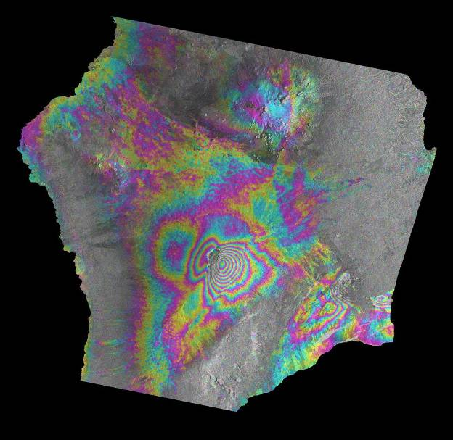
ENVISAT interferogram spanning November 2003 to January 2006 and showing inflation of the summits of Kilauea and Mauna Loa volcanoes, along with subsidence along both of Kilauea’s rift zones.
inflation
MAUNA LOA
KILAUEA
unpublished data from Mike Poland
subsidence

Slide 30
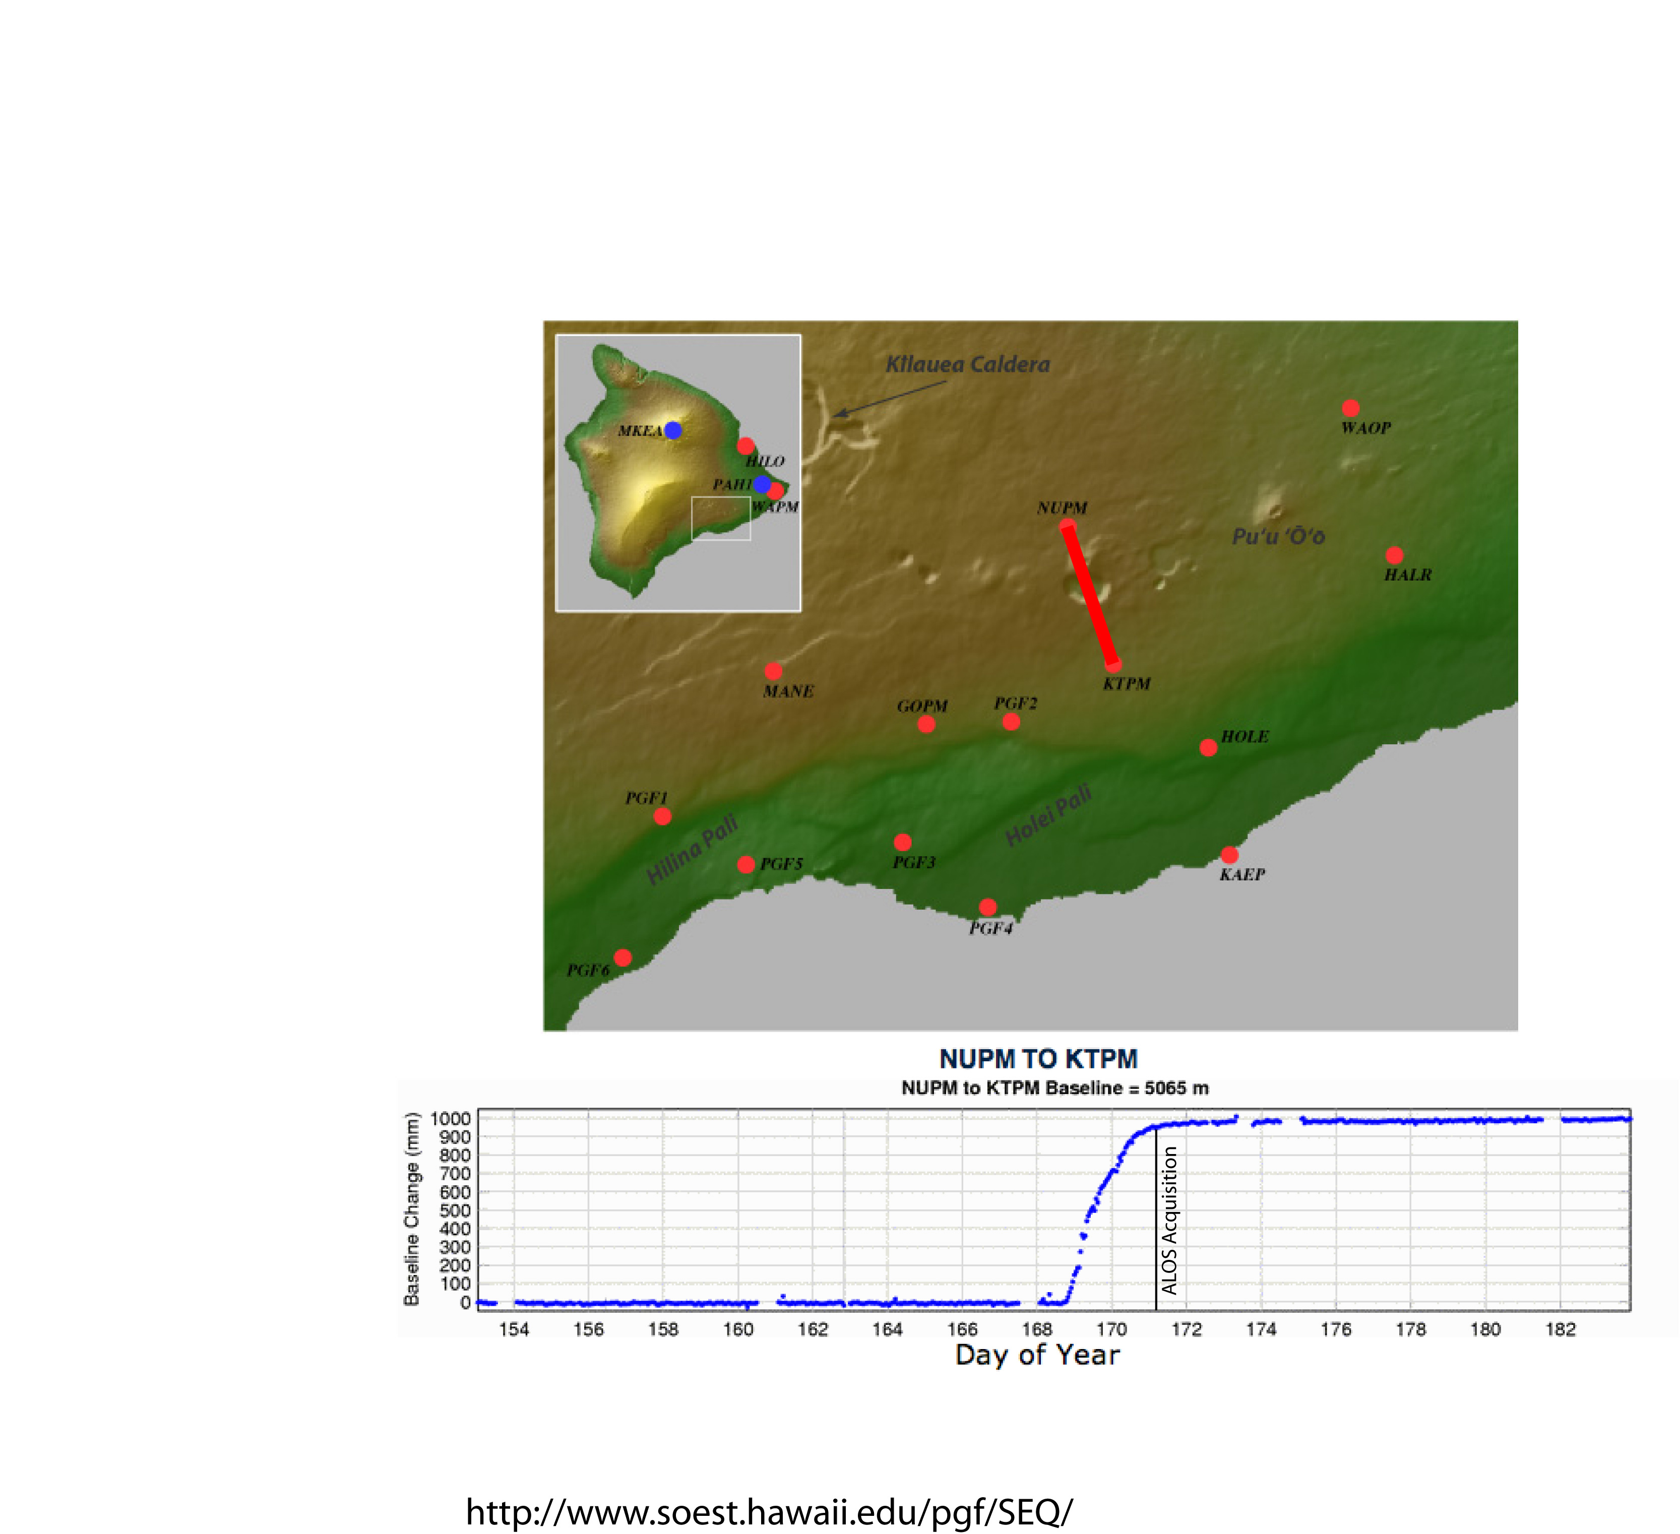
Kilauea - East Rift Zone, Dike Event
June 17 - June 21, 2007
data from: http://www.soest.hawaii.edu/pgf/SEQ/

Slide 31
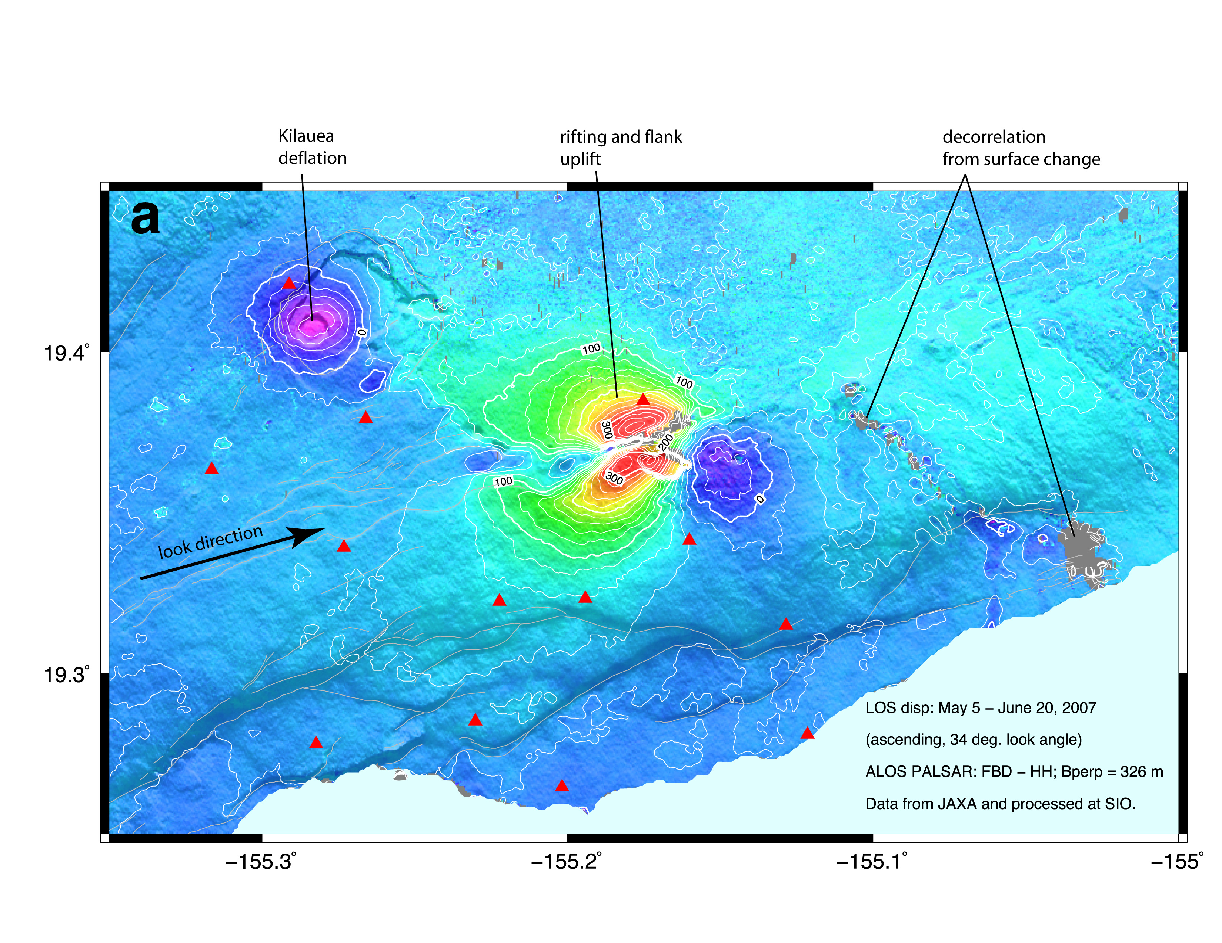
Dike event - LOS ascending
Sandwell et al., 2008

Slide 32
Earthquake Hazards

Slide 33
Coseismic deformation of the Maule, Chile earthquake, ALOS-1
ScanSAR
provides second look direction
[Tong et al., 2010]

Slide 34
Interseismic Deformation

Slide 35
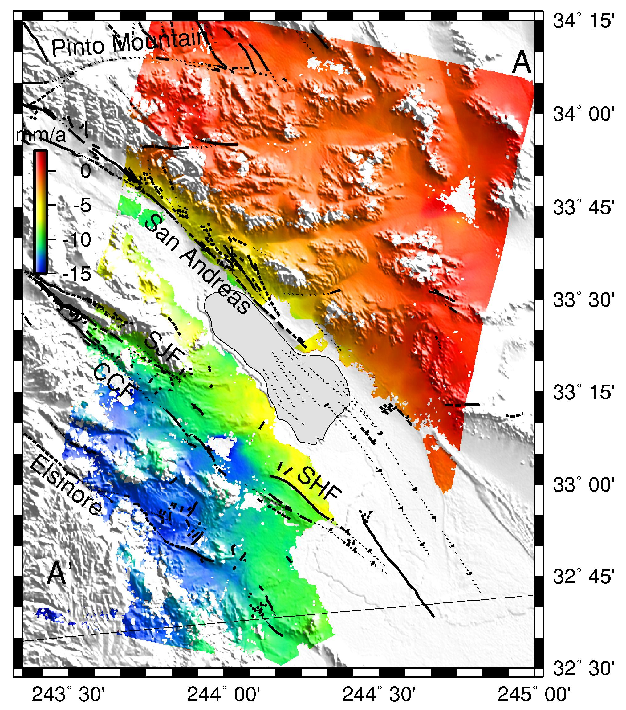
Fialko, Nature 2006
Line of sight
velocities from
stacked InSAR
data
35 interferograms
Epoch: 1992-2000
Southern
SAF

Slide 36
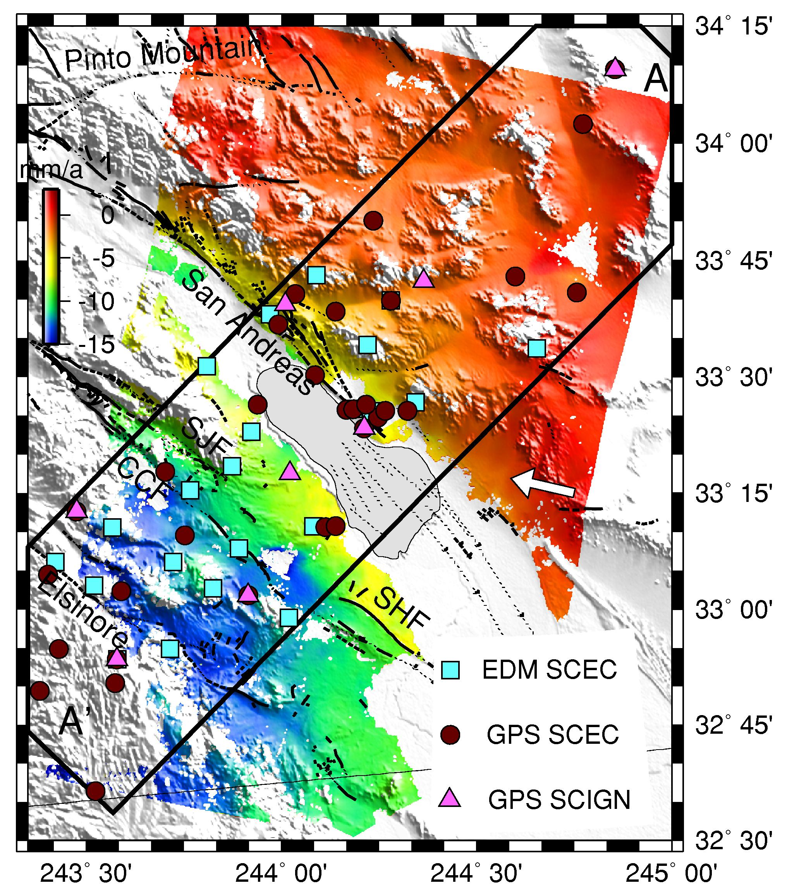
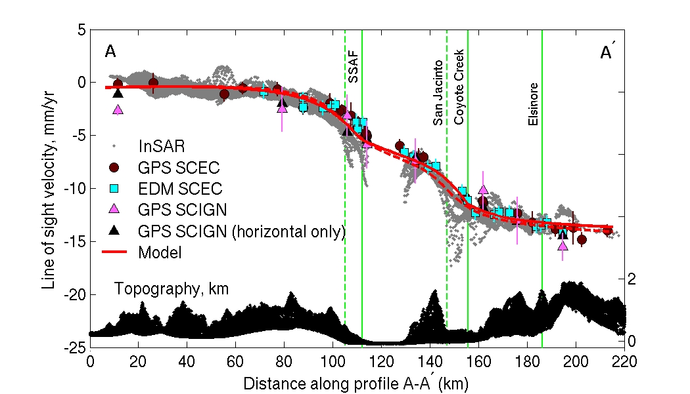
Fialko, Nature 2006
Line of sight
velocities from
stacked InSAR
data
35 interferograms
Epoch: 1992-2000
Southern
SAF

Slide 37
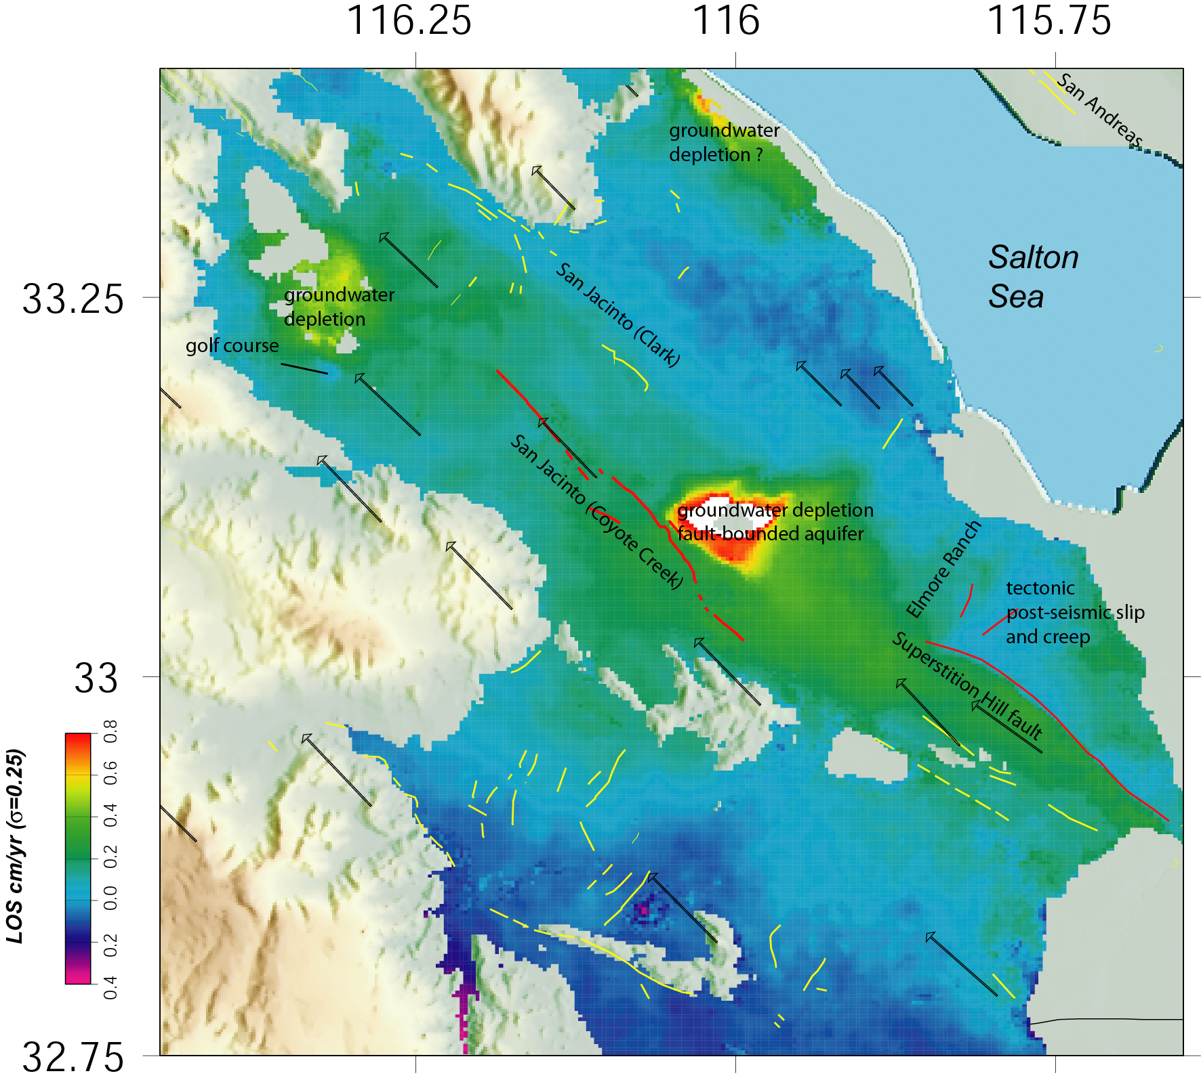
Western Salton trough 1992-2000
R. Mellors, SDSU
ERS 1,2 descending, 65 stacked interferograms

Slide 38
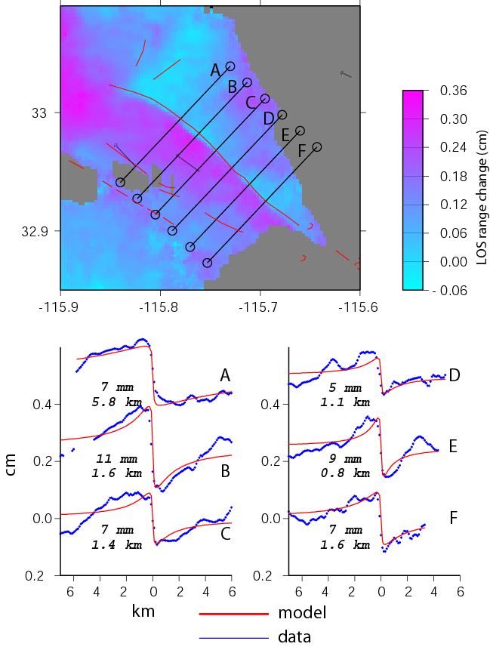
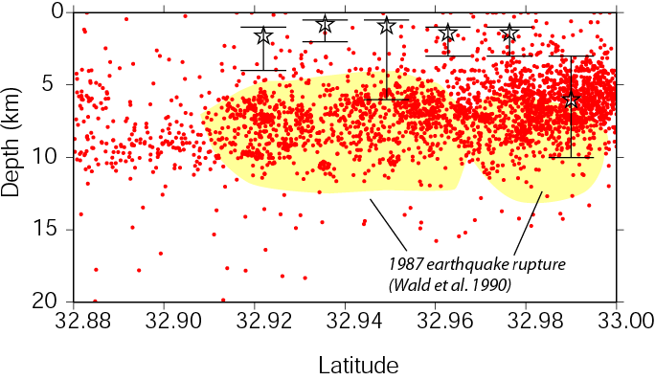
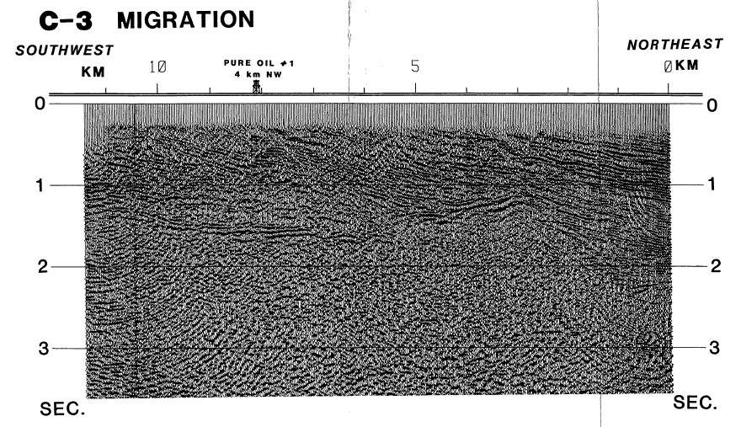
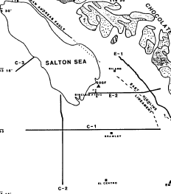
Fault zone behavior
Depth of slip
Depth of aseismic creep (1992-2000) on the Superstition Hill fault in comparison to microseismicity (red dots) and 1987 rupture (yellow).
Superstition Hill fault
Creep is shallow and appears to occur primarily in the sedimentary section above the seismic zone.
(from Rob Mellors)
sediment
basement
From Lutz et al. 1987

Slide 39
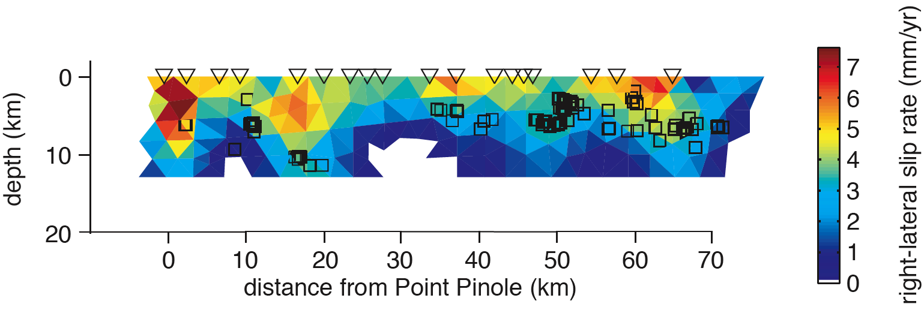
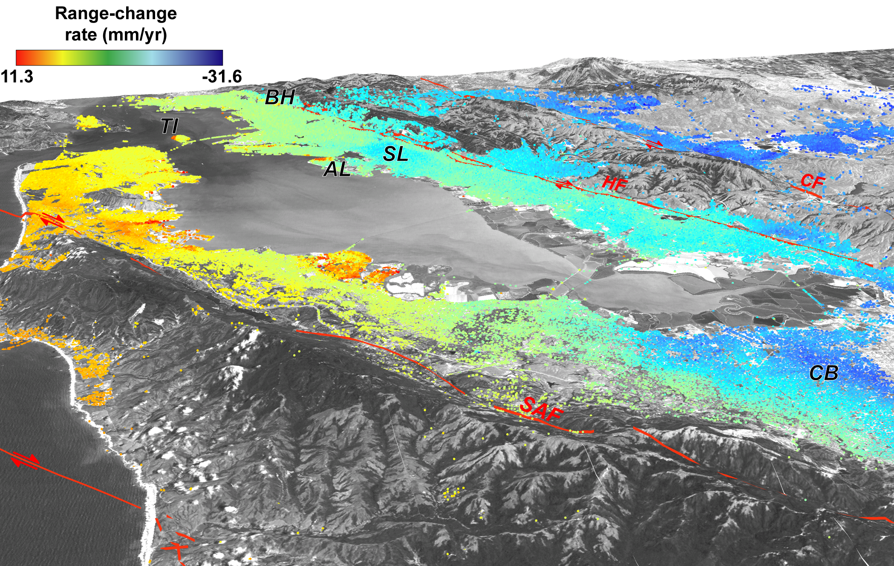
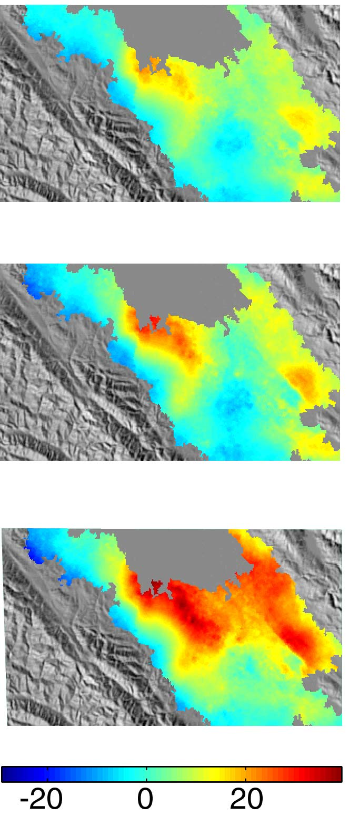
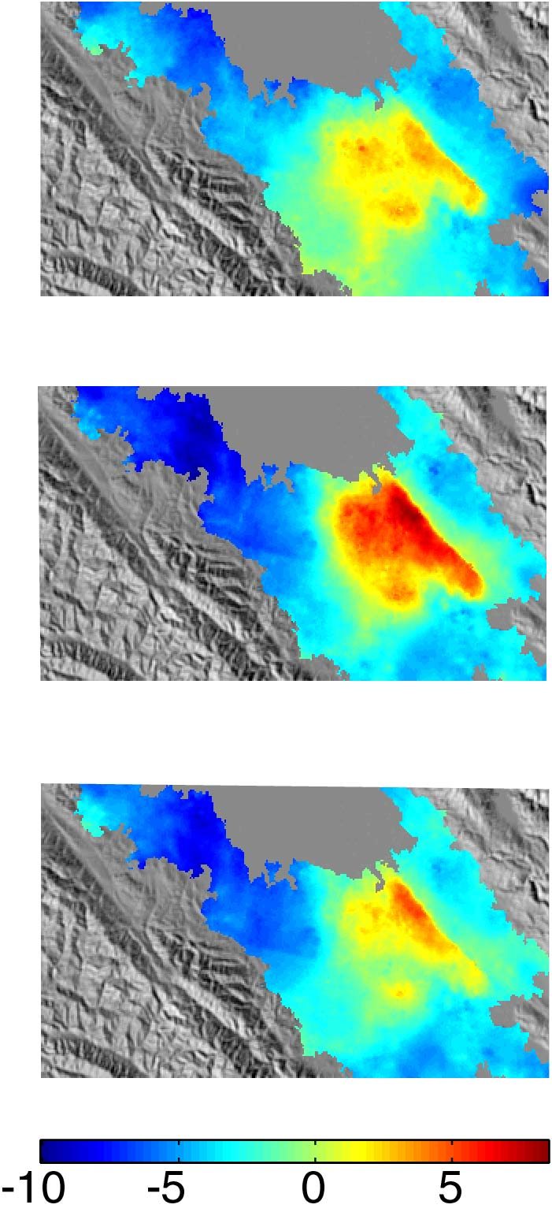
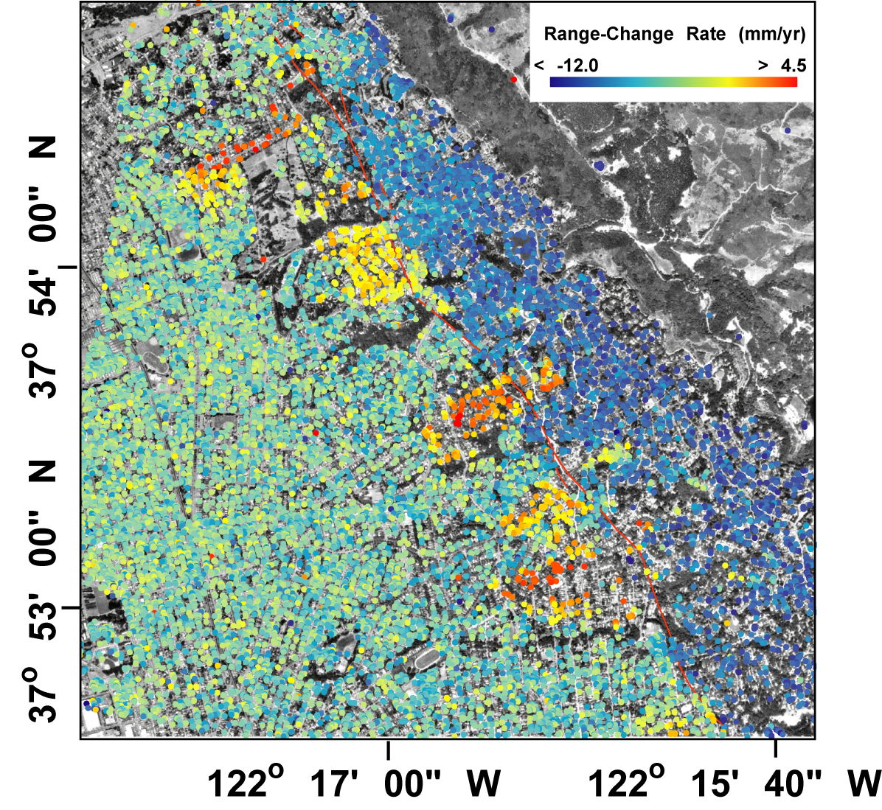

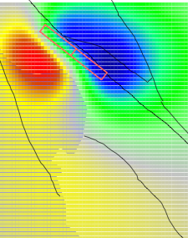
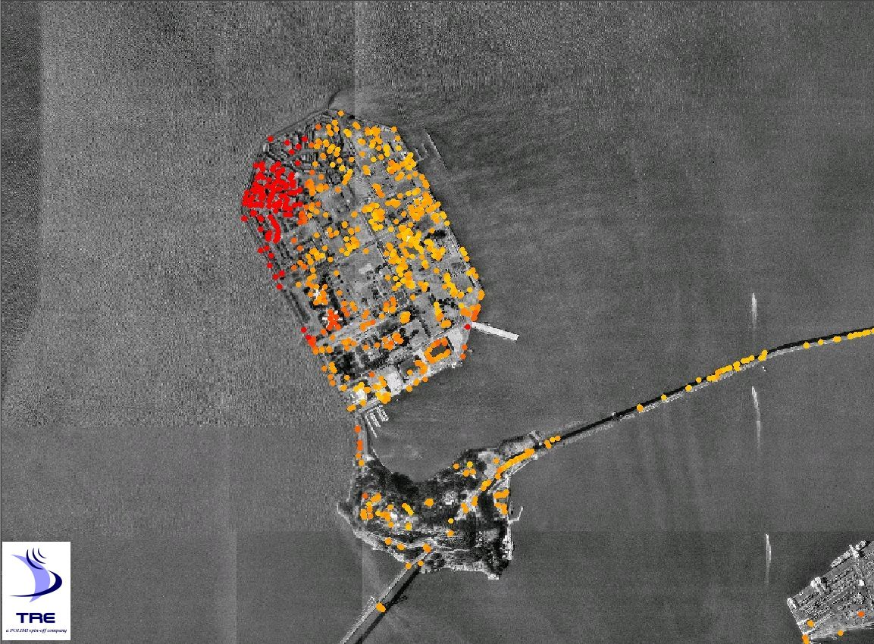
Schmidt et al., 2005, JGR
Schmidt and Bürgmann, 2003, JGR
Year-To-Year
Seasonal
September 1995
September 1997
September 1999
November 1998
March 1999
May 1999
Uplift [mm]
Uplift [mm]
LP
Ferretti et al., 2004
η_{m} = 6.7 x 10¹⁸ Pa s
Bürgmann, Pollitz et al.,2005 in prep., GRL
Ferretti et al., 2004, Eos
Hilley et al., 2004, Science
Notes:
49 ERS acquisitions from 1992 to 2000 were used to develop the permanent scatterer data set shown here. In addition to the plate-boundary strain evidenced by the (orange-to-blue) range-change gradient across the San Andreas fault system in the Bay Area, these data reveal (1) the distribution of aseismic slip and seismic potential of the Hayward fault and at San Juan Bautista, (2) the dynamics of aquifer deformation in the Santa Clara Valley, (3) rapid settling along the margins of San Francisco Bay, such as at Treasure Island, (4) dynamics of deep-seated landslides in the Berkeley Hills, and (5) the rheology of the upper mantle from postseismic relaxation following the 1989 Loma Prieta earthquake (evidenced by ≤ 2 mm/yr subsidence there).

Slide 40
Hydrological Applications

Slide 41
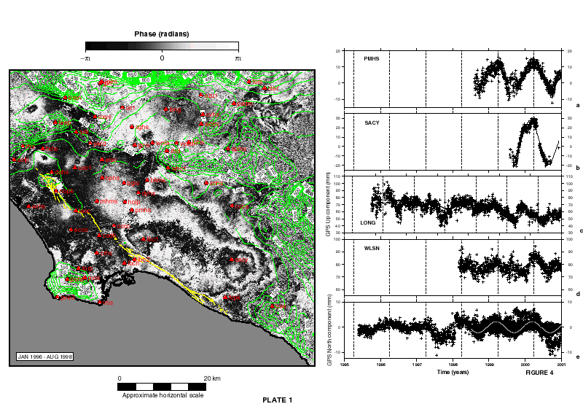
Annual groundwater recharge in LA Basin
(Watson et al., JGR 2001)
GPS Data

Slide 42
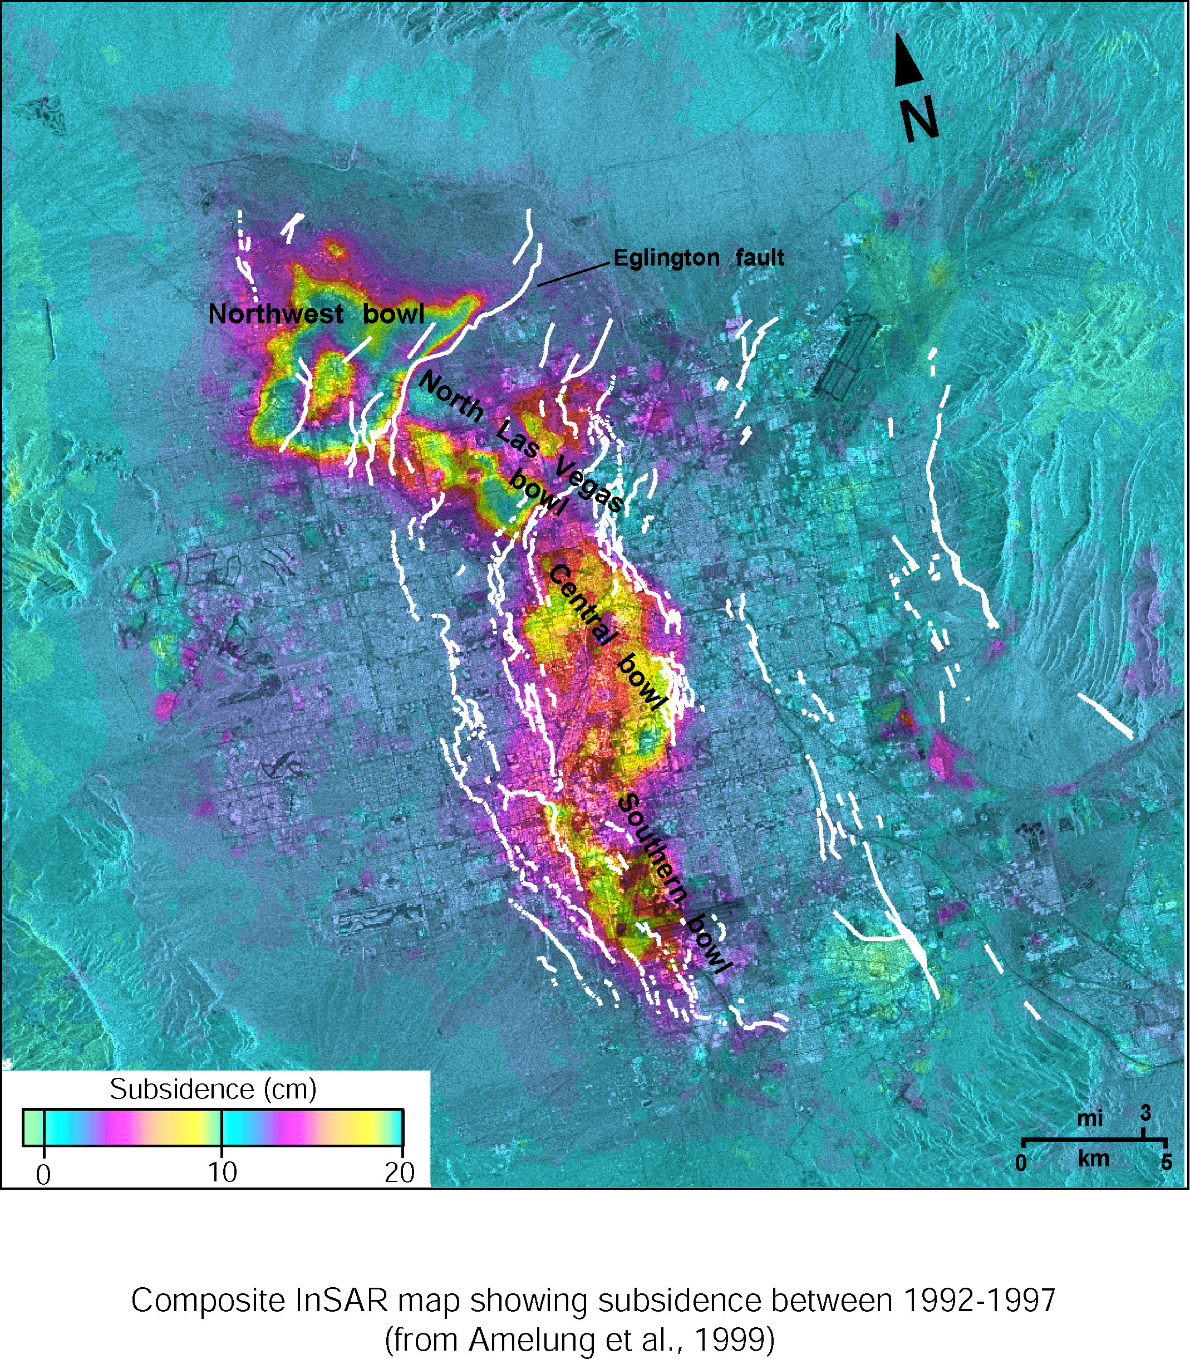
Groundwater Pumping, Las Vegas
(Amelung et al., Geology, 1999)

Slide 43
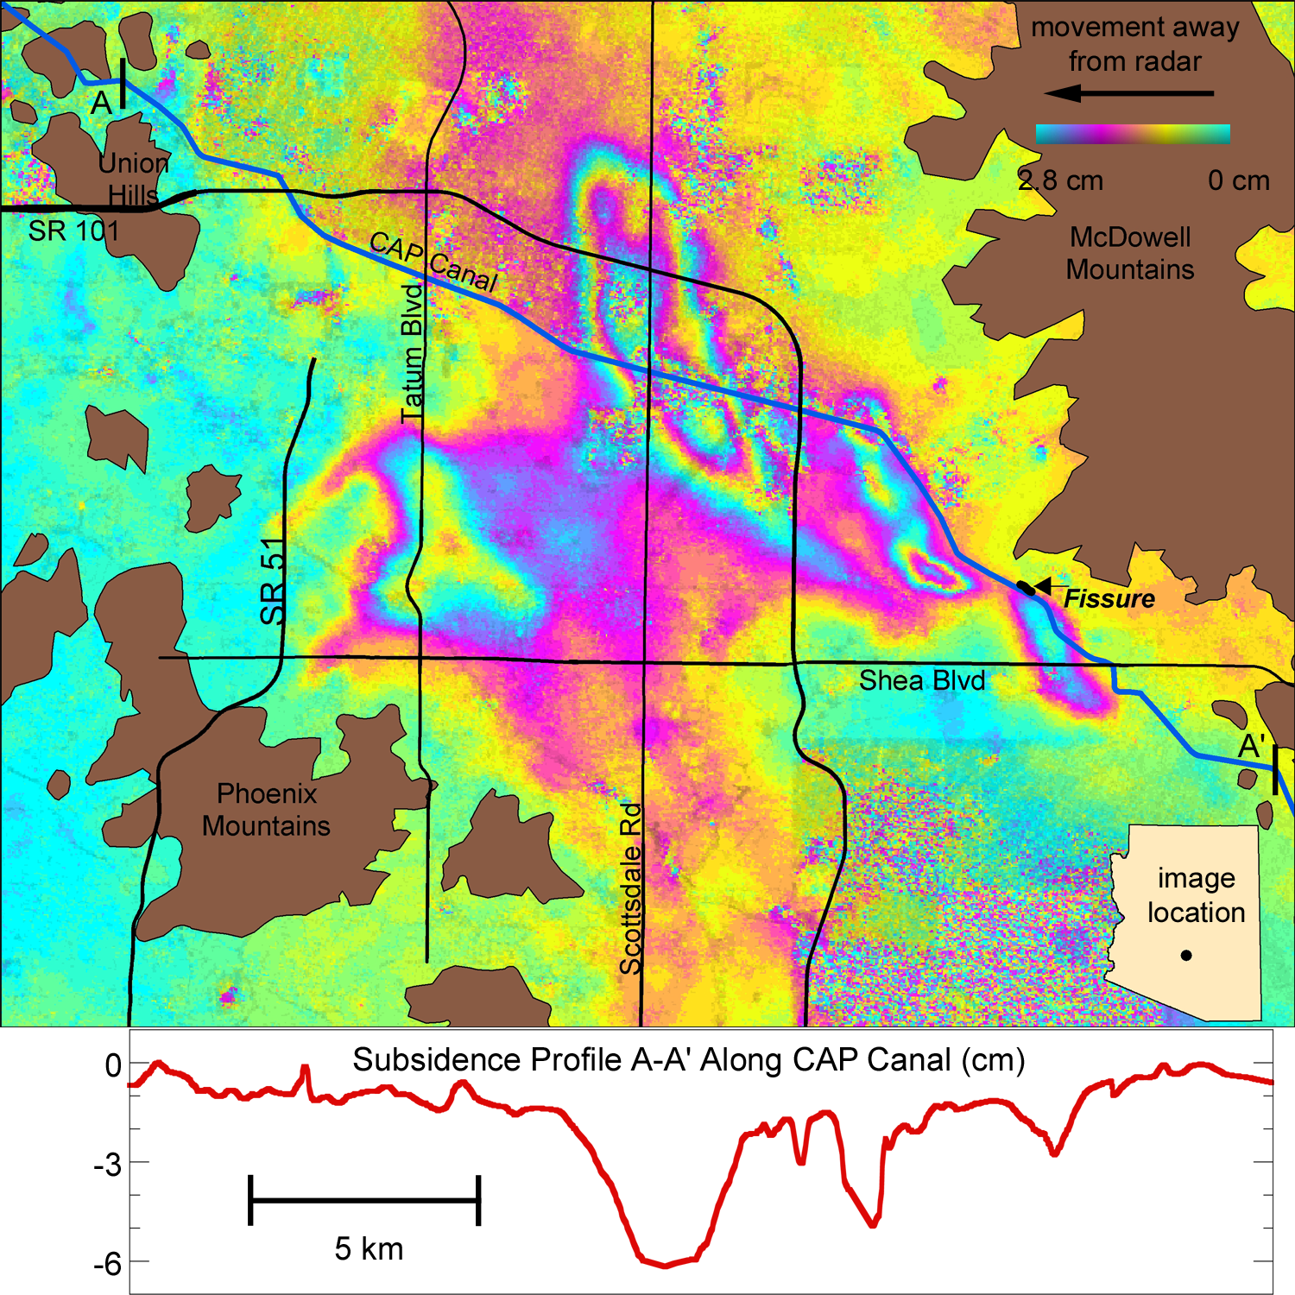
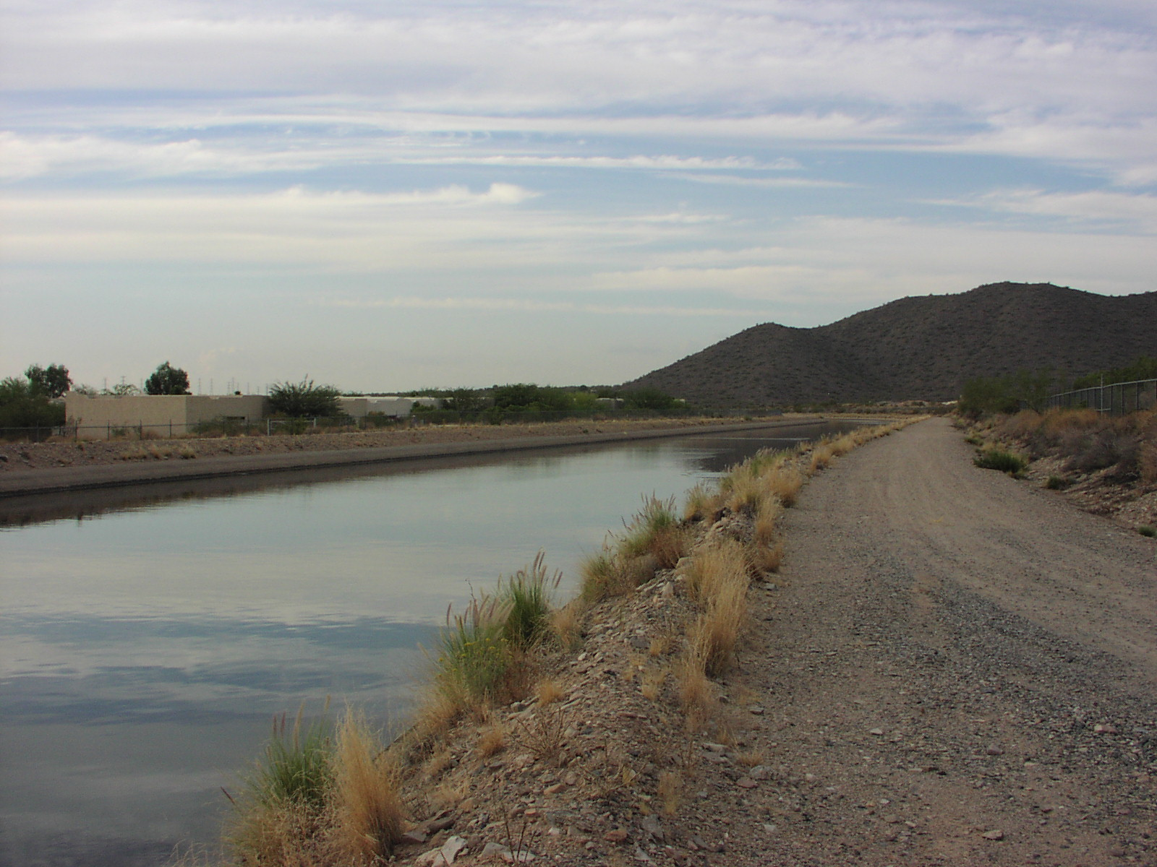
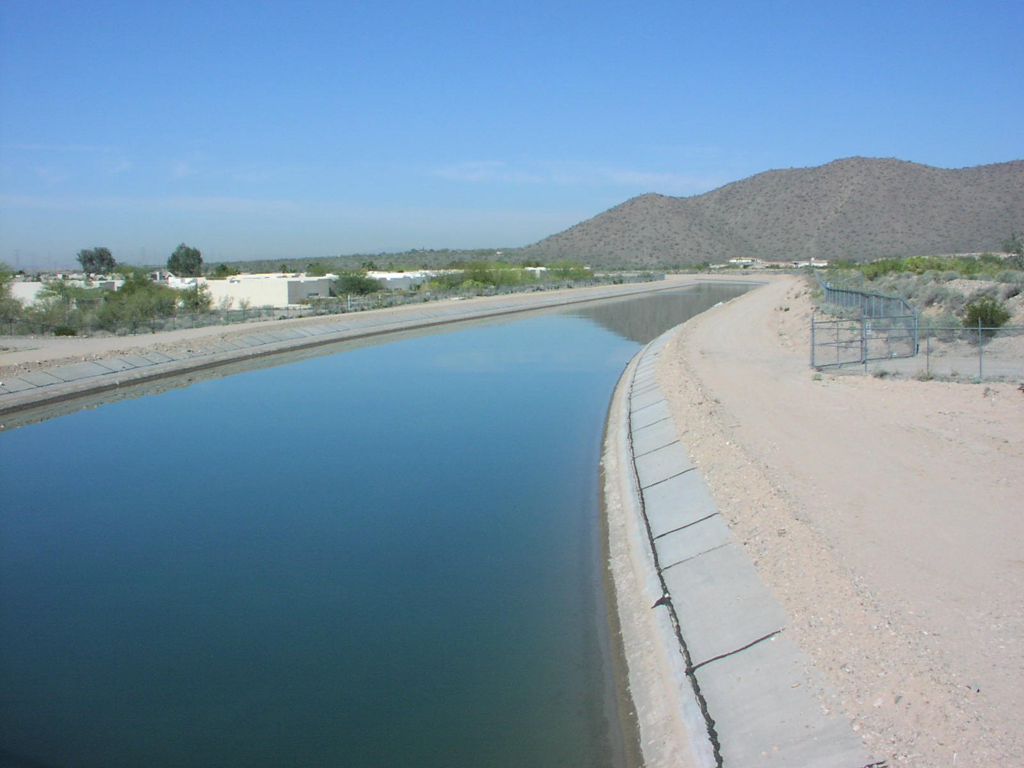
Subsidence Measuring – Northeast Phoenix /
North Scottsdale
(Buckley et al., 2003)
Oct 2001
Mar 2003
decorrelated
freeboard
added

Slide 44
InSAR Technology and Method

Slide 45
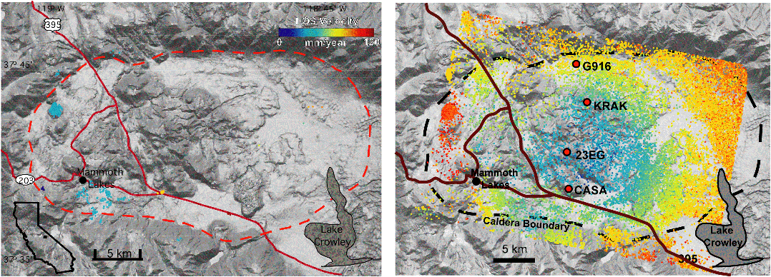

Persistent scatterers
Long Valley Caldera,
Hooper et al. 2004

Slide 46


Wide-swath InSAR
Bam earthquake
Rosen, 2006
Strip / ScanSAR InSAR
Bertran-Ortiz, 2007

Slide 47

Atmospheric Corrections
From Foster et al., correction of Hawaii interferograms
Weather models can predict large-scale atmospheric signal

Slide 48


Split-Beam Processing for 2-D
Split-beam processing yields 2-D vectors
Bechor, 2006

Slide 49
SAR and InSAR Overview
atmosphere is very transparent to microwaves
radars measure range and azimuth
radar image has amplitude and phase
amplitude depends on roughness, slope, and dielectric constant.
phase differences reveal topography
phase differences reveal deformation
deformation from: volcanoes, earthquakes, groundwater
WInSAR has large archive of ERS, Envisat and ALOS data
Notes:
49

